Slide 1
Office Workstation Ergonomics

Slide 2
Introduction
How to Use this Presentation
DISCLAIMER This training material presents very important, pertinent information. It should not be assumed, however, that this program satisfies every legal requirement of every state. Some states require the training be developed and delivered by an individual with specific training and experience.
This training is AWARENESS LEVEL and does not authorize any person to perform work or validate their level of competency; it must be supplemented with operation and process-specific assessments and training, as well as management oversight, to assure that all training is understood and followed. Your organization must do an evaluation of all exposures and applicable codes and regulations. In addition, establish proper controls, training, and protective measures to effectively control exposures and assure compliance.
This program is neither a determination that the conditions and practices of your organization are safe, nor a warranty that reliance upon this program will prevent accidents and losses or satisfy local, state, or federal regulations.
This presentation contains base material for use in an instructor-led training setting. You may modify this presentation to satisfy the specific training needs of your organization.
On some slides, the display text is supplemented with additional material in the slide notes.
This content is licensed for modification and use in a classroom setting. You may not redistribute this material in any form.

Slide 3
Course Overview
Introduction
DISCLAIMER This training material presents very important, pertinent information. It should not be assumed, however, that this program satisfies every legal requirement of every state. Some states require the training be developed and delivered by an individual with specific training and experience.
This training is AWARENESS LEVEL and does not authorize any person to perform work or validate their level of competency; it must be supplemented with operation and process-specific assessments and training, as well as management oversight, to assure that all training is understood and followed. Your organization must do an evaluation of all exposures and applicable codes and regulations. In addition, establish proper controls, training, and protective measures to effectively control exposures and assure compliance.
This program is neither a determination that the conditions and practices of your organization are safe, nor a warranty that reliance upon this program will prevent accidents and losses or satisfy local, state, or federal regulations.
Part 1: Your Chair
Part 2: Your Keyboard and Mouse
Part 3: Your Monitor
Part 4: Your Environment
Summary

Slide 4
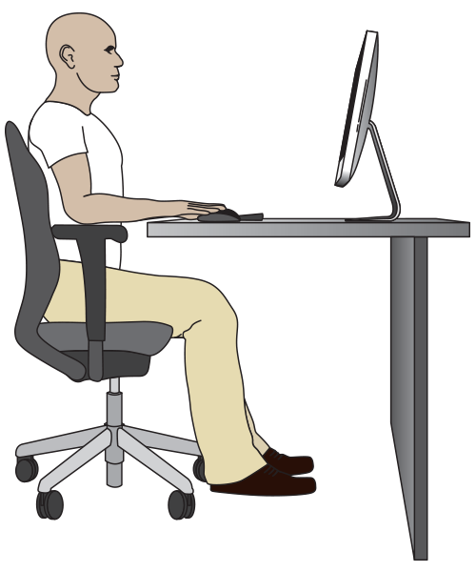
1
Your Chair
Your chair is more than just a place to sit. It is also a tool for improving the ergonomic conditions of your workstation. Best practices for selecting the chair include suitability for the individual, good lumbar support, five legs and casters, and multiple points of adjustability.
In this section, we will look at your seating conditions related to the following components:
Seat height
Seat back
Seat depth
Seat pan tilt
Armrest position

Slide 5
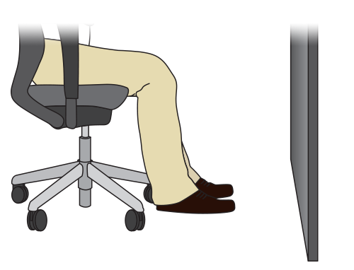
1 Your Chair
Seat Height
Best Practice Adjust your seat height to meet the following conditions:
Your feet are flat on the floor
Flat on floor
Notes:
Adjust your seat height so that your feet are flat on the floor or on a foot rest,

Slide 6
Seat Height
1 Your Chair
Best Practice Adjust your seat height to meet the following conditions:
Your feet are flat on the floor
Your knees are bent at angle of 90° or greater
90°or slightly greater
Notes:
your knees are bent at right angles,

Slide 7
1 Your Chair
Seat Height
Best Practice Adjust your seat height to meet the following conditions:
Your feet are flat on the floor
Your knees are bent at angle of 90° or greater
Your thighs are horizontal to the floor.
Horizontal to floor
Notes:
and your thighs are horizontal to the floor.
If you cannot adequately lower your chair, a foot rest will help maintain a neutral posture.

Slide 8
1 Your Chair
Seat Tilt
Best Practice Adjust your seat pan tilt and back support so that your hips and the tops of your thighs are at right angles or slightly greater.
Right angle
or slightly
greater
Notes:
Adjust your seat pan tilt and back support so that your hips and the tops of your thighs are at right angles or slightly greater.

Slide 9
Seat Back
1 Your Chair
Best Practice Adjust your seat back so that it supports the lumbar curve of your spine. If the curve of the seat is inadequate, you may need to consider a new chair or a lumbar support attachment.
Lumbar
curve
Recommendation
Notes:
Adjust your seat back so that it supports the lumbar curve of your spine. If the curve of the seat is inadequate, you may need to consider a new chair or a lumbar support attachment.

Slide 10
1 Your Chair
Seat Depth
Best Practice Adjust your seat pan depth so that the seat cushion is about 1 – 4” from the backs of your knees. A secondary option is to consider a different chair.
1 to 4 inches
Notes:
Adjust your seat pan depth so that the seat cushion is about 1 – 4” from the backs of your knees. A secondary option is to consider a different chair.

Slide 11
2
Your Keyboard and Mouse
The position of your keyboard and mouse is critical to proper body mechanics at your workstation. In this section, we will look at the position of your mouse and keyboard.
Keyboard height
Keyboard-to-user distance
Neutral hand postures
Mouse height
Mouse-to-user distance

Slide 12
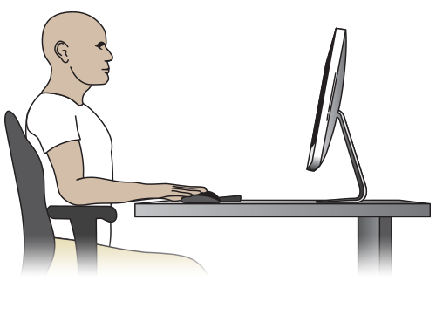
2 Your Keyboard and Mouse
Keyboard and Mouse Height
Best Practice Adjust keyboard height so that both your arms and forearms are at right angles or slightly greater (90° – 105°) and both your forearms and hands form straight lines.
90°to 105°
Notes:
Adjust keyboard height so that arms and forearms are at right angles or slightly greater.
Your forearms and hands should form straight lines.

Slide 13
2 Your Keyboard and Mouse
Distance from Keyboard
Best Practice The distance between you and your keyboard should allow you to relax your shoulders. Your elbows should hang close to your body.
Notes:
The distance between you and your keyboard should allow you to relax your shoulders.
Your elbows should hang close your body.

Slide 14
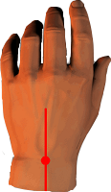
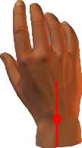
2 Your Keyboard and Mouse
Neutral Hand Posture (lateral)
Best Practice Adjust your desk height, keyboard, or mouse position so that your wrists are in straight lines. This maintains neutral hand posture.
Do not bend your wrists to the sides.
Straight lines
Notes:
Adjust your desk height, keyboard, or mouse position so that your wrists are in straight lines. This maintains neutral hand posture.
Do not bend your wrists to the sides.

Slide 15
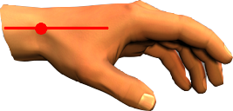
2 Your Keyboard and Mouse
Neutral Hand Posture (vertical)
Best Practice Just as wrists should not bend horizontally, they also should not bend vertically.
Keep wrists in straight lines to maintain neutral posture. Do not bend your wrists upward or downward.
Straight lines
Notes:
Just as wrists should not bend horizontally, they also should not bend vertically. Keep wrists in straight lines to maintain neutral posture.
Do not bend your wrists upward or downward.

Slide 16
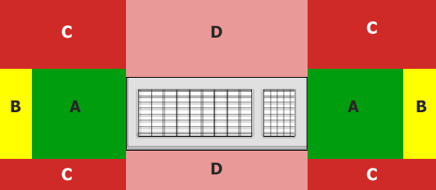
2 Your Keyboard and Mouse
Mouse Location
Best Practice Your mouse should be directly next to the keyboard in the A position.
Notes:
Your mouse should be directly next to the keyboard in the A position.

Slide 17
3
Your Monitor
If your monitor is not adjusted correctly, it could affect your entire posture and create neck, shoulder, and back problems. The correct monitor height is critical to protecting your neck, shoulders, back, and eyes.
In this section, we will look at the position of your monitor:
Monitor height
Monitor-to-user distance
Monitor alignment with user
Visual comfort of screen
Personal factors, such as corrective lenses or eyewear

Slide 18
3 Your Monitor
Monitor Height
Within
2 or 3
inches
Best Practice Adjust your monitor so that your eye level falls within 2” – 3” of the top of the screen. NOTE: If you have eyewear, such as progressive lenses, your monitor may need to be additionally adjusted to meet your needs.
Notes:
Adjust your monitor so that your eye level falls within 2” – 3” of the top of the screen.
NOTE: If you have eyewear, such as progressive lenses, your monitor may need to be additionally adjusted to meet your needs.

Slide 19
3 Your Monitor
Monitor-to-User Distance
16 – 28”
Best Practice The monitor screen should be 16” – 28” from your eyes.
In addition, adjust for corrective lenses and personal comfort.
NOTE: If you have eyewear, such as progressive lenses, your monitor may need to be additionally adjusted to meet your needs.
Notes:
The monitor screen should be 16” – 28” from your eyes. In addition, adjust for corrective lenses and personal comfort.
NOTE: If you have eyewear, such as progressive lenses, your monitor may need to be additionally adjusted to meet your needs.

Slide 20
3 Your Monitor
Monitor Position
Best Practice Position your primary monitor directly in front of you.
Directly in front
Notes:
Position your primary monitor directly in front of you.

Slide 21
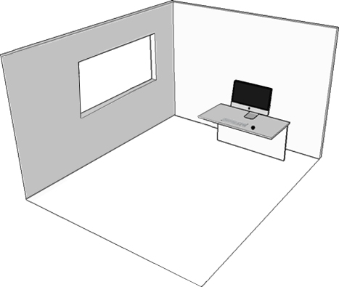
3 Your Monitor
Natural Light
Best Practice Position your primary monitor perpendicular to the strongest source of natural light.
In other words, the incoming light should be to your side, not behind you or in front of you.
Notes:
Position your primary monitor perpendicular to the strongest source of natural light. In other words, the incoming light should be to your side, not behind you or in front of you.

Slide 22
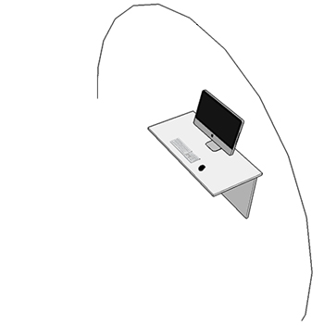
3 Your Monitor
Artificial Light
Best Practice As with natural light, position your primary monitor so that the light is to the sides or above. Avoid light shining in your eyes or reflecting off of your monitor.
C
Notes:
As with natural light, position your primary monitor so that the light is to the sides or above. Avoid light shining in your eyes or reflecting off of your monitor.

Slide 23
4
Your Environment
Proper organization and set-up of your work area and surrounding environment is critical. In this section, we will look at your environment and work area. The following elements will be evaluated:
Frequently used items
Contact trauma
Storage of cabinets and equipment
Leg clearance
Lighting

Slide 24
4 Your Environment
Placement of Frequently Used Items
Best Practice Frequently used items should be positioned as near as possible to reduce awkward reaching postures.
Notes:
Frequently used items should be positioned as near as possible to reduce awkward reaching postures.

Slide 25
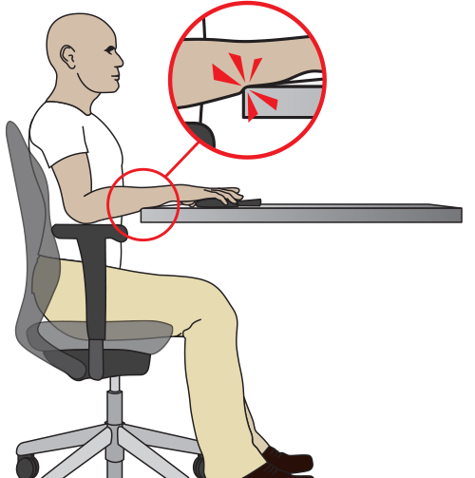
4 Your Environment
Contact Trauma
Best Practice Avoid contact with sharp edges by lowering your tabletop height to recommended levels or using a keyboard or mouse wrist pad.
Notes:
Avoid contact with sharp edges by lowering your tabletop height to recommended levels or using a keyboard or mouse wrist pad.

Slide 26
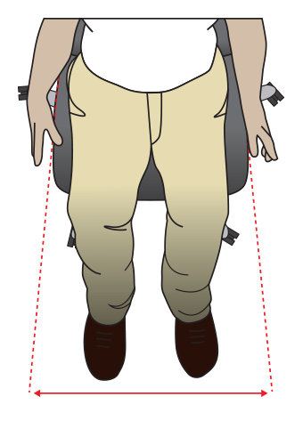
4 Your Environment
Leg Room Width
Best Practice Your leg room width should include the width of your hips plus two inches.
Notes:
Your leg room width should include the width of your hips plus two inches.

Slide 27
4 Your Environment
Leg Room Height
Best Practice Your leg room height should be greater than or equal to the highest point of your thighs.
Highest point of thighs
Notes:
Your leg room height should be greater than or equal to the highest point of your thighs.

Slide 28
4 Your Environment
Leg Room Depth
Best Practice Your leg room depth must allow for a comfortable sitting position.
Notes:
Your leg room depth must allow for a comfortable sitting position.

Slide 29
Summary
Ergonomics impact your long-term health, and minor problems can become major over time. Your work space should be comfortable, allowing you to maintain a neutral position most of the time.
Recommendations:
Talk to your supervisor about making the changes you need.
Take care of your health in general to improve your posture at work and to reduce the risk of injury.
Make sure that you are not staying in the same position for too long. Move around throughout the day.

