Slide 1
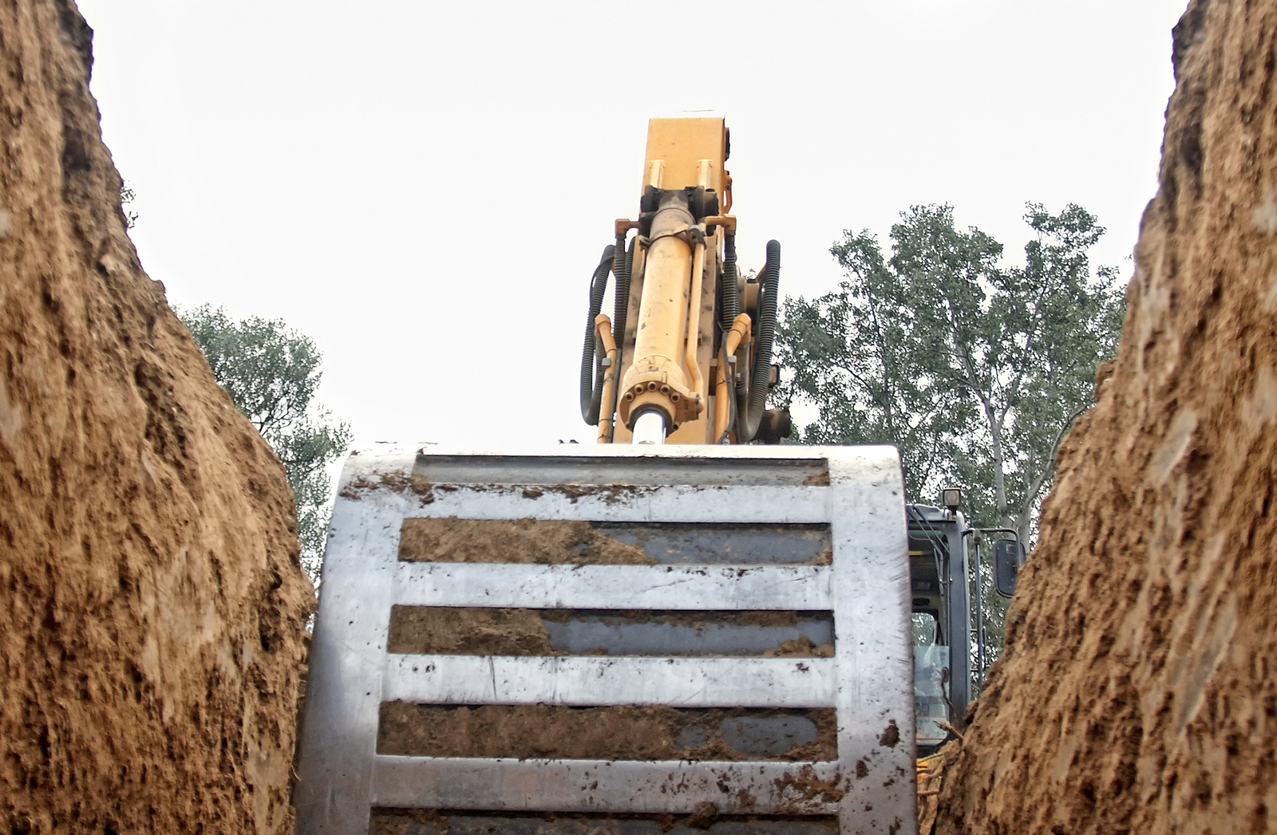
Trenching and Shoring
Notes:
Welcome to this training presentation on Trenching and Shoring.
Please use the forward and backward arrows at the bottom left of this page to navigate through the training at your own pace.
This presentation includes quiz questions, which will appear after every few slides.
You must answer the questions before the training will continue.
If you are unsure of the correct answer to any question, you may go backward to reread the information so that you can fully understand the message.
Thank you for doing your best to learn this important information.

Slide 2
Disclaimer
This training material presents very important, pertinent information. It should not be assumed, however, that this program satisfies every legal requirement of every state. Some states require the training be developed and delivered by an individual with specific training and experience.
This training is AWARENESS LEVEL and does not authorize any person to perform work or validate their level of competency; it must be supplemented with operation and process-specific assessments and training, as well as management oversight, to assure that all training is understood and followed.
Your organization must do an evaluation of all exposures and applicable codes and regulations. In addition, establish proper controls, training, and protective measures to effectively control exposures and assure compliance.
This program is neither a determination that the conditions and practices of your organization are safe, nor a warranty that reliance upon this program will prevent accidents and losses or satisfy local, state, or federal regulations.

Slide 3
Introduction
Trenches are one of the most dangerous environments in the worksite. Every month, a trench collapse kills two workers.
Assure that all necessary precautions and controls are in place to protect yourself and others.
Notes:
Trenches are one of the most dangerous environments in the worksite. Every month, a trench collapse kills two workers.
Assure that all necessary precautions and controls are in place to protect yourself and others.

Slide 4
Course Outline
1. Planning a Safe Excavation
2. Soils
3. Soil Inspections
4. Cave-in Hazards
5. Sloping and Benching
6. Shoring and Shielding
7. General Safety Measures

Slide 5
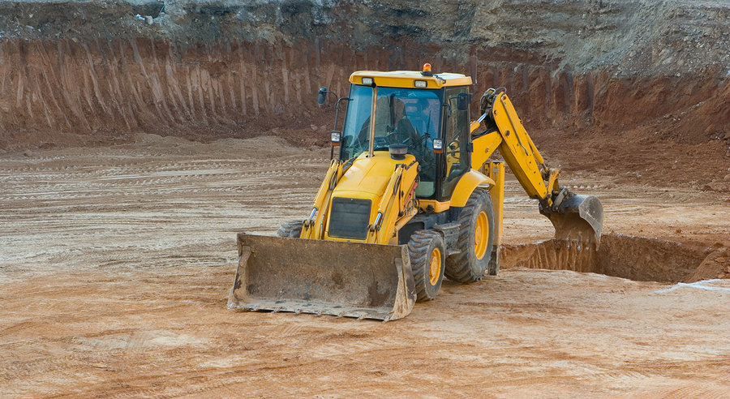
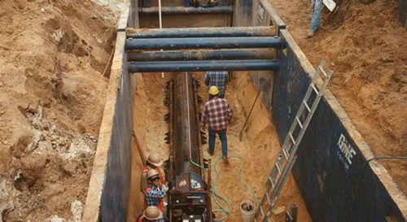
Excavation and Trenching
An excavation is any man-made pit, hole, or trench created in the ground by removing earth.
A trench is a specific type of excavation, which tends to be narrow relative to its length, no wider than 15 feet, and deeper than it is wide.

Slide 6
Competent Person and Registered Engineer
“‘Competent person’ means one who is capable of identifying existing and predictable hazards in the surroundings, or working conditions which are unsanitary, hazardous, or dangerous to employees, and who has authorization to take prompt corrective measures to eliminate them.”
“‘Registered Professional Engineer’ means a person who is registered as a professional engineer in the state where the work is to be performed. However, a professional engineer, registered in any state is deemed to be a ‘registered professional engineer’ within the meaning of this standard when approving designs for ‘manufactured protective systems’ or ‘tabulated data’ to be used in interstate commerce.”
OSHA 1926, Subpart P

Slide 7
Planning a Safe Excavation
Part
1
What you need to know:
The components of an excavation plan
What to consider when planning an excavation
How to read color-coded field markings

Slide 8
Planning Your Excavation
Planning a Safe Excavation
Inadequate planning is the cause of many trenching accidents.
Careful planning is crucial for each new job, regardless of how extensive your trenching or excavating experience might be. Taking the time to make sure everything is in place prior to starting the job can save time, money, and lives.
Plan components include the following:
Scope and duration of trench digging and related work
Evaluation of soil classifications and conditions
Evaluation of above-ground worksite considerations
Evaluation of hazards

Slide 9
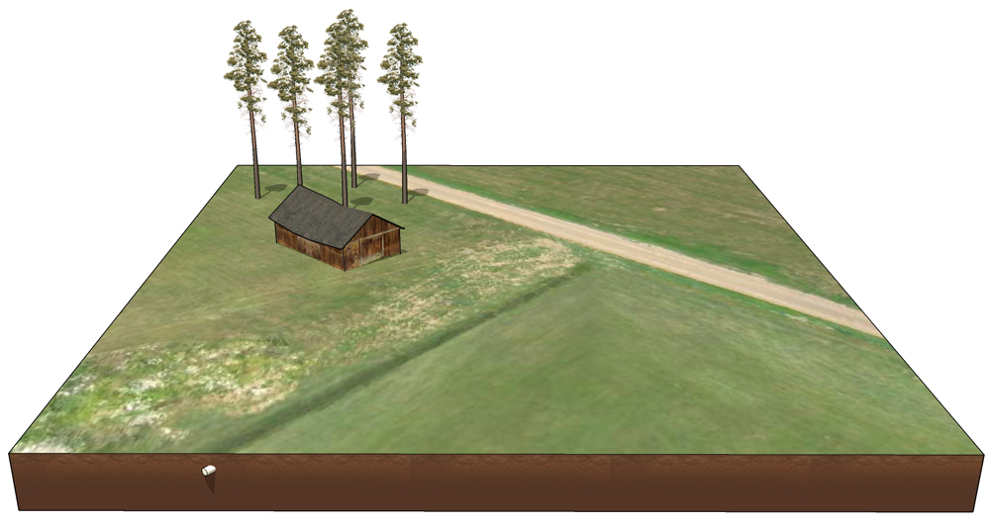
Planning Considerations
Planning a Safe Excavation
What is the excavation for?
Notes:
Understanding the purpose of the excavation is the first step to establishing a plan that maximizes safety and efficiency at your work site.
For example, if the excavation will install a large utility line, the logistics will directly affect your planning process.

Slide 10
Planning Considerations
Planning a Safe Excavation
50’ long
4’ wide at floor
12’ deep
How large is the planned excavation?
Notes:
How large is the planned excavation?
As a trench grows in length, width, or depth, additional precautions must be taken to assure that the excavation remains stable.
In this example, the trench will be four feet wide at its floor, twelve feet deep, and fifty feet long.

Slide 11
Planning Considerations
Planning a Safe Excavation
2-week excavation in mid-July
How long will the excavation be open?
Notes:
How long will the excavation remain open?
The longer an excavation is open, the more opportunities it will have to weaken.
Make sure that protective systems are sturdy enough to last for the entire duration.
This trench is being planned for a two-week excavation in mid-July, which is a relatively short duration.

Slide 12
Planning Considerations
Planning a Safe Excavation
Sunny (little chance of precipitation)
What kinds of weather can be expected?
Notes:
What kinds of weather can be expected?
Factors such as temperature and precipitation can negatively affect the trench as well as affect personnel and equipment.
The forecast in the example indicates that the next two weeks will be sunny, with little chance of precipitation.

Slide 13
Planning Considerations
Planning a Safe Excavation
Area clear of large rocks and roots
Are there surface encumbrances present in the excavation area?
Notes:
Are there surface encumbrances present in the excavation area?
Surface encumbrances are features that may need to be removed, worked around, or replaced. They can be synthetic structures, such as foundations, roads, sidewalks, or utility poles, or they can be natural features such as large rocks, bodies of water, trees, or root systems.
The planned area of this trench is free of any such encumbrances. If they were present, they would need to be removed prior to beginning work.

Slide 14
Planning Considerations
Planning a Safe Excavation
Barn present 15 ft. from excavation edge
Are there any structures near the excavation area?
Notes:
Are there any structures near the excavation area?
Nearby structures can be hazardous to excavations and vice versa. An excavation too close to a structure or its foundation may weaken it, while vibrations from the structure may likewise weaken the sides of the excavation. Consider whether it includes any subterranean structures or underground utilities such as plumbing.
In this instance, a barn is present fifteen feet from the edge of the excavation. It does not have underground structures or utilities but vibration could still be a factor.

Slide 15
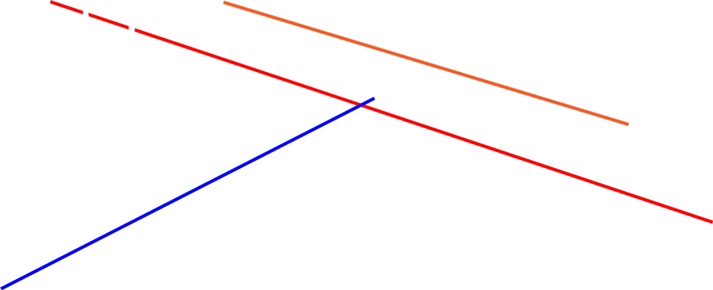
Planning Considerations
Planning a Safe Excavation
Electrical line
Datacom line
Irrigation line
What kinds of underground utilities can be expected?
Notes:
What kinds of underground utilities can be expected?
Before beginning the excavation, be aware of any other underground lines that may run through or near the planned path of the trench. Any utilities must be clearly marked, and care must be taken to not disrupt their functionality.
Electrical and Datacom lines run in close proximity to the planned trench, and an irrigation line runs right through it.

Slide 16
Planning Considerations
Planning a Safe Excavation
Water table
Will water pose a problem?
Notes:
Will water pose a problem?
Water can create several serious hazards, such as by weakening trench walls, accumulating in the bottom of the trench, or quickly creating conditions in which personnel or equipment may get stuck.
When planning an excavation, make sure to identify the depth of the site’s water table. Also, make sure to identify any other potential sources of water.
In this example, the water table is lower than the planned depth of the excavation and should not be a problem. However, the nearby irrigation line needs to be planned for.

Slide 17
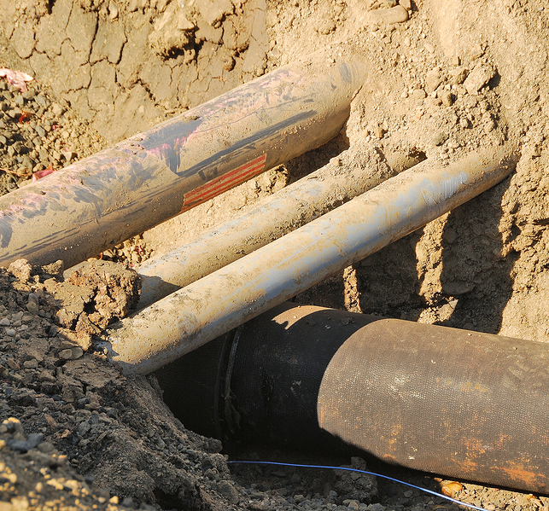
Planning Considerations
Planning a Safe Excavation
Previous pipe
installation
Is there evidence that the soil was previously disturbed?
Notes:
Is there evidence that the soil was previously disturbed?
This section of the area had previously been excavated to lay the irrigation line.
Previously disturbed soil is important to identify before determining the soil classification. Soil classifications are discussed on the next slide.

Slide 18
Planning Considerations
Planning a Safe Excavation
Type A soil
What soil classifications are present?
Notes:
What soil classifications are present?
Soil classification is important because each type requires a different protective system.
The majority of this area is comprised of type A soil. However, soil that was previously disturbed cannot be classified as type A, regardless of its composition, and must be classified separately from the surrounding soil. So the previously disturbed soil is either type B or type C.
In this example, the soil is type C.

Slide 19
Planning Considerations
Planning a Safe Excavation
Type A soil
Mostly dry (110 – 125 lbs./ft²)
What are is the moisture level of the soil?
Notes:
What is the moisture level of the soil?
Soil’s moisture level affect its cohesiveness and its classification. If soil is showing a higher level of moisture, it might be at risk of destabilizing.
Here, the soil is mostly dry.

Slide 20
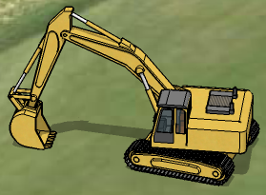
Planning Considerations
Planning a Safe Excavation
What peripheral loads will be present?
Notes:
What peripheral loads will be present?
Peripheral loads are materials on the surface by the excavation, including excavation equipment, vehicles, and excavated soil or “spoils.”
If loads are placed too close to the edge of the excavation, they can weaken the surface and trench walls, leading to collapse.
Peripheral loads must be placed beyond the trench’s “failure zone.” The failure zone is a distance from the edge of the trench that is usually equal to half the trench’s depth, though it varies based on the trench wall’s angle.

Slide 21
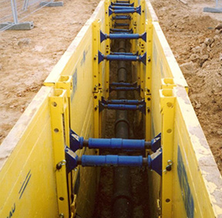
Planning Considerations
Planning a Safe Excavation
What protective systems are required?
Notes:
What protective systems are required?
Protective systems must be tailored to the characteristics of the excavation and to specific sections of the excavation if necessary.
The planned path of this trench includes two separate soil classifications, so the system design must include appropriate methods to assure safe working conditions in each type.

Slide 22
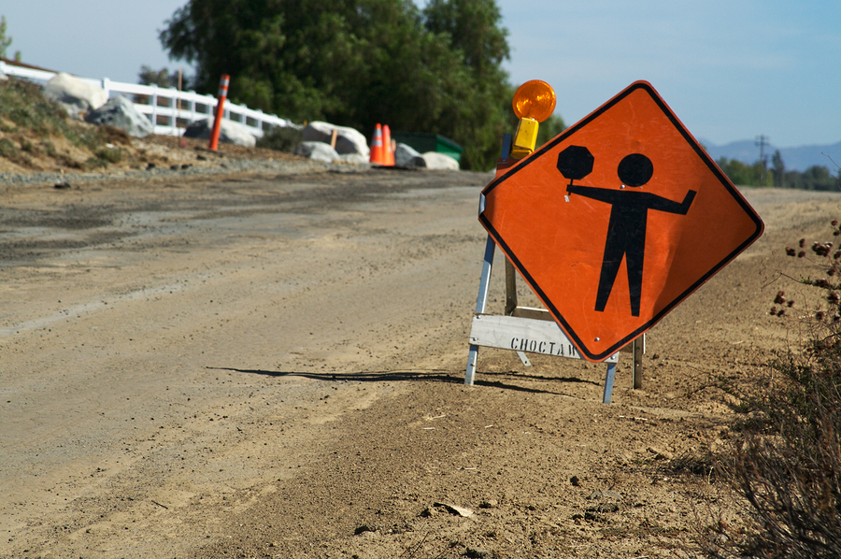
Planning Considerations
Planning a Safe Excavation
Is traffic control needed?
Notes:
Is traffic control needed?
If an excavation is in close proximity to pedestrian or vehicular traffic, then extra precautions must be taken to assure the safety to both the on-site personnel and those in traffic.
Consider factors such as the traffic volume, what sort of work needs to be performed at the part of the trench closest to the road, and how the vibration from road traffic may affect the cohesion of the soils.
In this situation, the trench is close enough to the road that vibration will be a factor. Traffic control is needed.
When panning a safe excavation, you must consider these and many other factors. This course will help to build the competency needed to make the right call.

Slide 23
Planning Considerations
Planning a Safe Excavation
Notes:
When planning a safe excavation, you must consider these and many other factors. This course will help to build the competency needed to make the right call.

Slide 24
Mapping Existing Conditions
Planning a Safe Excavation
Use color coded field markings to efficiently map out and communicate hazards on site.
WHITE Proposed excavation
RED Electric power lines, cables or conduits, and lighting cables
YELLOW Gas, oil, steam, petroleum or other hazardous liquid or gaseous materials
ORANGE Communications, cable TV, alarm or signal lines, cables, or conduits
BLUE Water, irrigation, and slurry lines
GREEN Sewers, storm sewer facilities, or other drain lines
PINK Temporary survey markings
PURPLE Reclaimed water, irrigation, and slurry lines

Slide 25
Soils
Part
2
What you need to know:
The four soil classifications and their general properties
How to identify structural hazards by being aware of soil mechanics

Slide 26
Soil Classifications
Soils
For purposes of excavation planning and safety, soil is classified as one of the following:
Stable rock (strongest)
Type A
Type B
Type C (weakest)
To assure maximum safety, many contractors plan trenching operations under the assumption that all soil is type C.

Slide 27
Classification Criteria
Soils
Unconfined compressive strength:
A soil’s type is determined by its unconfined compressive strength, or the load per unit area that would cause the compressed soil to collapse.
Angle of repose:
A soil’s maximum angle of repose is the steepest angle at which it remains stable.
The maximum angle of repose will vary depending on the soil classifications being excavated.
No trench slope should exceed a soil’s maximum angle of repose.

Slide 28
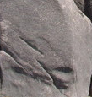
Soils
Stable Rock
Rather than granular materials and clay, this soil classification is comprised of solid rock, making it the strongest.
Maximum safe angle of repose:
90° (0:1, meaning 0 horizontal to 1 vertical)
Stable rock deposits are usually referred to by their primary mineral, e.g. granite or sandstone.
In stable rock, excavation walls can be vertical and unsupported.

Slide 29
Stable Rock
Soils
It is sometimes difficult to determine if a deposit is stable rock prior to excavating.
Surface cracks may be an indication that the soil is not stable rock.

Slide 30
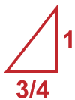
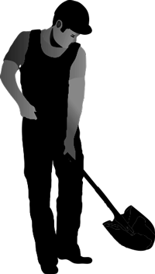
Type A
Soils
Type A soil has high cohesion and plasticity.
Unconfined compressive strength: 1.5 tons per square foot (tsf) or greater
Maximum safe angle of repose: 53° (3/4:1)
Examples:
Clay
Silty clay
Sandy clay
Clay loam

Slide 31
Type A
Soils
Soil is not classified as type A if it:
Is fissured.
Is seeping water.
Was previously disturbed.
53

Slide 32
Type B
Soils
Type B soil is granular and lacks cohesion.
Unconfined compressive strength: Between 0.5 and 1.5 tsf
Maximum safe angle of repose: 45° (1:1)
Examples:
Angular gravel
Silt
Silt loam
Sandy loam
Silty clay loam and sandy clay loam can be either type A or B.

Slide 33
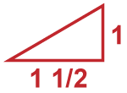
Type C
Soils
Type C soil is the least cohesive soil type.
Unconfined compressive strength: 0.5 tsf or less
Maximum safe angle of repose: 34° (1-1/2:1)
Examples:
Gravel
Sand
Loamy sand
Submerged soil
Soil from which water is freely seeping
Submerged, unstable rock
34

Slide 34
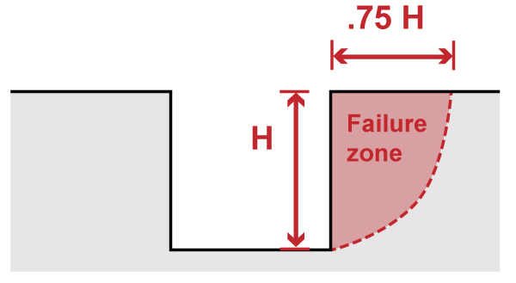
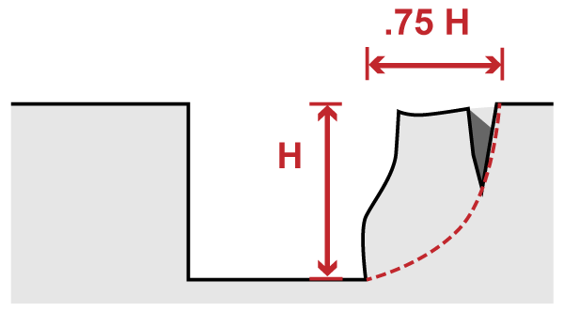
Understanding Soil Mechanics
Soils
Excavation walls can withstand a certain amount of stress or deformation that affect their stability (e.g., moisture content or surface pressure) before they will collapse.
For this reason, it is essential to minimize stress within the failure zone.
Failure zone:
The failure zone is a distance around the trench which is 0.5 – 0.75 of the trench’s depth. Signs of soil stress, such as tension cracks, found in this area indicate a risk of cave-in. Tension cracks:
Tension cracks run parallel to the trench. If found in the failure zone, chances of a cave-in significantly increase.

Slide 35
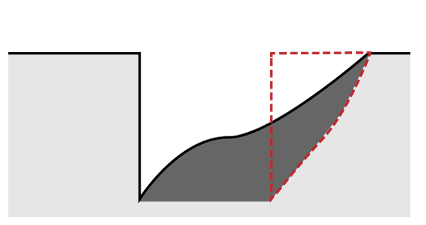
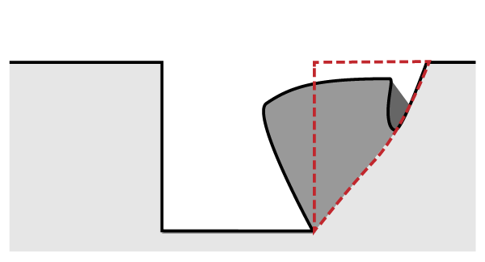
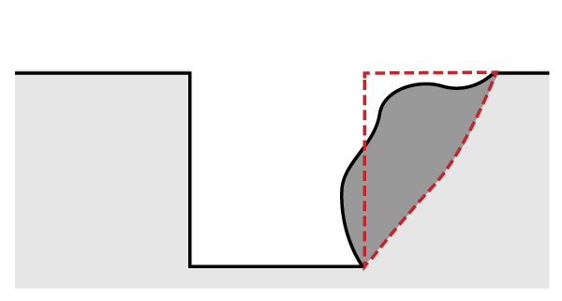
Soil Mechanics—Danger Signs
Soils
Sliding:
Sliding, or sloughing, can occur when the soil is weakened by tension cracks. (See illustration below.)
Toppling:
Toppling is another potential consequence of tension cracks. The trench’s wall splits along the tension crack line and falls into the trench.
Bulging and subsidence:
Insufficiently supported excavations can lead to uneven stress in the soil. Subsidence, or sinking, in the surface and bulges in the trench’s walls may result.
If these conditions are left uncorrected, trench collapse is likely.

Slide 36
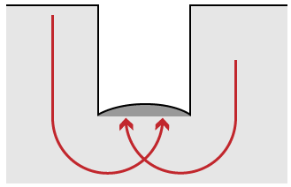
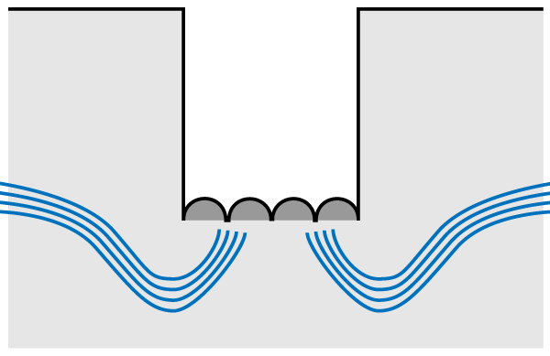
Soil Mechanics—Bottom Heaving and Boiling
Soils
Bottom heaving or squeezing:
Bottom heaving or squeezing occurs when downward pressure from the weight of the adjacent soil causes a bulge in the bottom of the trench.
These conditions can be dangerous if your trench is not properly shored.
Boiling:
Boiling refers to water flowing up into the bottom of the trench, usually due to a high water table. Boiling can create quick conditions in the trench.
Both heaving and boiling can occur even with appropriate protective systems in place.
Soil weight
Water table

Slide 37
Soil Inspections
Part
3
What you need to know:
Visual tests
Manual tests
Inspection equipment

Slide 38
Overview
Soil Inspections
At least one visual test and one manual test must be performed to assure accurate classification.
Laboratory testing can also be used to determine a soil sample’s strength.
The following parameters can help to determine soil classification:
Cohesive vs. granular: Soil is cohesive if it remains in clumps, or granular if it includes coarse sand or gravel.
Unconfined compressive strength
Manual tests include the following:
Thumb penetration test
Dry strength test
Plasticity test
Pocket penetrometer test
Shearvane (Torvane) test

Slide 39
The Visual Test
Soil Inspections
The visual test not only assists in classification, but also considers conditions around the worksite.
Observe the entire excavation site, including the soil being removed from the trench and soil adjacent to the excavation.
Observe the behavior of soil to see evidence of whether it is cohesive or granular.
ROLE: COMPETENT
PERSON

Slide 40
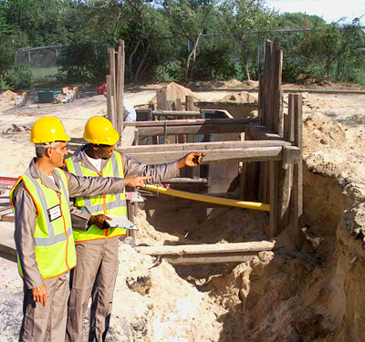
The Visual Test of the Failure Zone
Soil Inspections
Evaluate the excavation’s failure zone for the following:
Tension cracks
Surface or wall deformations
Indications that the soil has been previously disturbed
Layered soils
Intrusions such as building foundations
Proper distance of spoils from the excavation edge
Potential sources or signs of vibration
ROLE: COMPETENT
PERSON

Slide 41
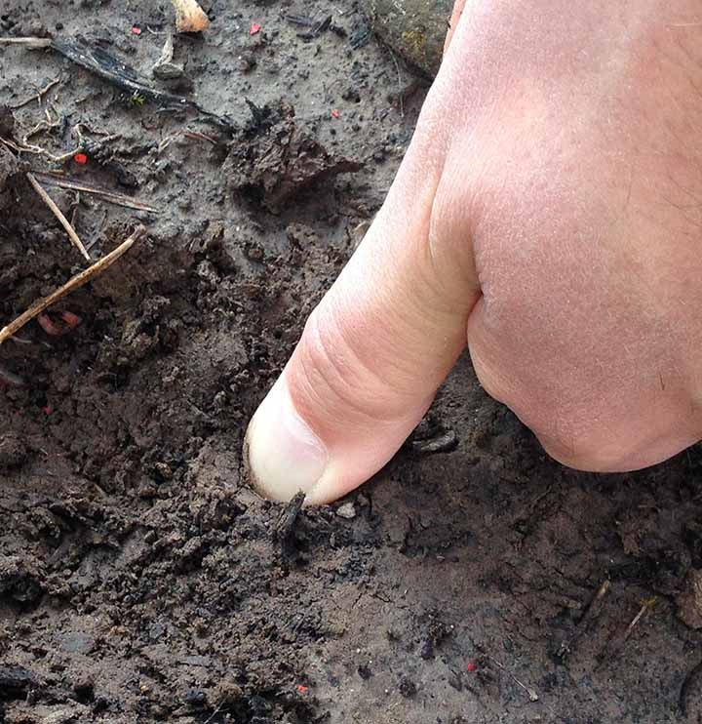
Thumb Penetration Test
Soil Inspections
This manual test focuses on soil strength, which will indicate one of the soil classifications. The subjectivity of thumb penetration testing makes it the least accurate manual test method. Use this test in conjunction with other manual tests.
ROLE: COMPETENT
PERSON
To perform a thumb penetration test, firmly press your thumb into the soil.
If the soil is not easily penetrated or your thumb does not make an indentation at all, it is likely type A .
If you can penetrate the soil down to the length of your thumbnail, it is likely type B.
If you can insert the full length of your thumb into the soil, it is likely type C.

Slide 42
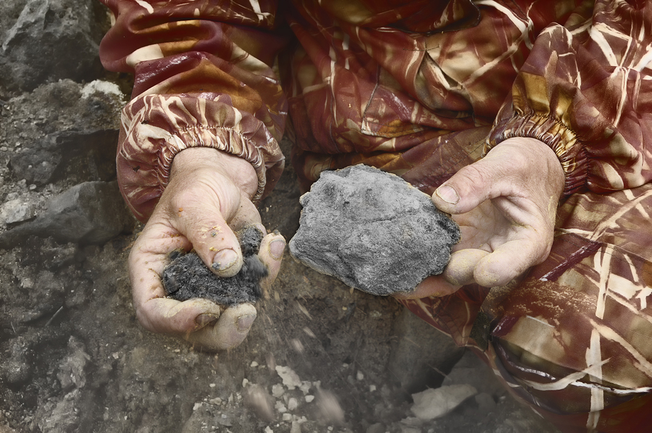
Dry Strength Test
Soil Inspections
To perform a dry strength test:
Let a small block of soil dry.
Apply enough pressure to break it.
Examine the granularity of the pieces.
Results:
If it falls into clumps which do not break up on their own (and there are no indications of fissuring), the dry soil is cohesive.
If it crumbles into individual grains with minimal pressure or on its own, the dry soil is granular.
If the dry soil initially crumbles easily but then the small clumps do not break up on their own, then the composition is likely a mix of clay and gravel, silt, or sand.
ROLE: COMPETENT
PERSON

Slide 43
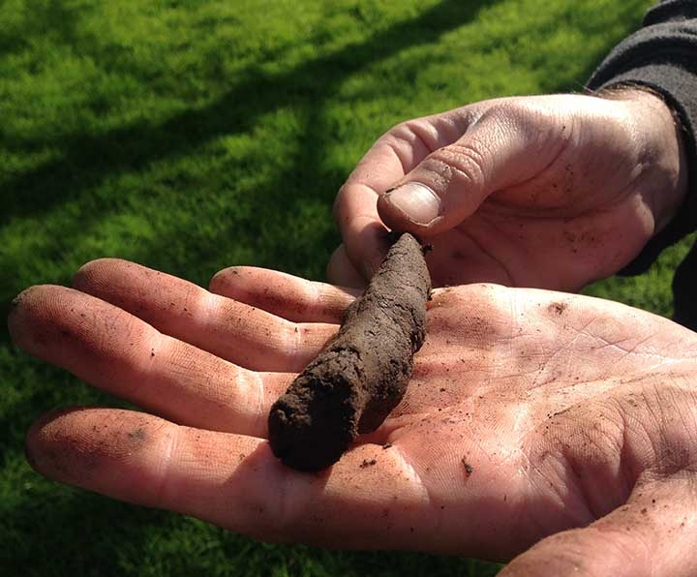
Plasticity Test
Soil Inspections
To perform a plasticity test:
Mold a moist soil sample into a ball.
Roll the ball into a thread approximately 1/8 inch in diameter by 2 inches long.
Hold the rolled sample by an end.
If the rolled sample does not break or tear, the soil is cohesive.
ROLE: COMPETENT
PERSON

Slide 44
Inspection Equipment
Soil Inspections
Pocket penetrometer test:
A penetrometer is a spring-operated gauge inserted directly into a soil sample to determine its unconfined compressive strength, which is displayed on an outer indicator sleeve.
Penetrometers can be calibrated either for imperial (tons per square foot, tsf) or metric (kilograms per square centimeter, kPa) measurements.
Please note that penetrometer results usually have a ± 20-40% margin of error.
Shear vane (Torvane) test:
Hand-operated shear vanes can also be used to determine a soil’s unconfined compressive strength, by pressing the vane’s blades into an undisturbed section of soil and adding pressure until the soil fails.
If using a shear vane, multiply the instrument’s reading by 2 to determine the soil’s tsf or kPa (based on the instrument’s calibration).
ROLE: COMPETENT
PERSON

Slide 45
Cave-in Hazards
Part
4
What you need to know:
The hazards involved with a cave-in

Slide 46
An Avoidable Fatality
Cave-in Hazards
Young Trench Worker Killed in Sudden Cave-in Accident A 22-year-old laborer was killed as he manually dug a trench for a pipe installation. The trench was about eight feet deep, and none of its walls were properly shored or sloped. When one of the walls collapsed, the victim was buried under six feet of soil.
Never enter a trench that is not properly inspected and protected.

Slide 47
Soil Weight
Cave-in Hazards
Soil is heavy. A cubic foot of soil often weighs more than 100 pounds.
A cubic yard weighs at least 2,700 pounds—roughly the equivalent of a compact car.
1 cubic foot of soil >100 lbs.
1 cubic yard of soil > 2700 lbs.
1 compact car 3100 lbs.

Slide 48
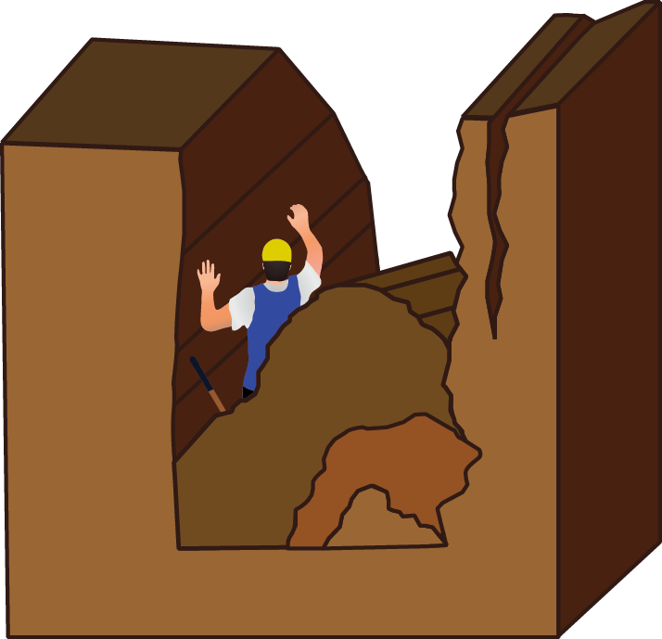
Cave-ins
Cave-in Hazards
54 fatalities per year
While trenching and excavation work poses a number of serious hazards, cave-ins are the deadliest, accounting for 76% of all fatalities for excavation workers. Cave-ins cause 54 fatalities a year.
1000 injuries per year
Cave-ins are also responsible for 1,000 injuries per year. 140 lead to permanent disability.
No warning
Cave-ins typically occur with no warning, so appropriate protective measures must be properly installed before any work in the excavation begins.

Slide 49
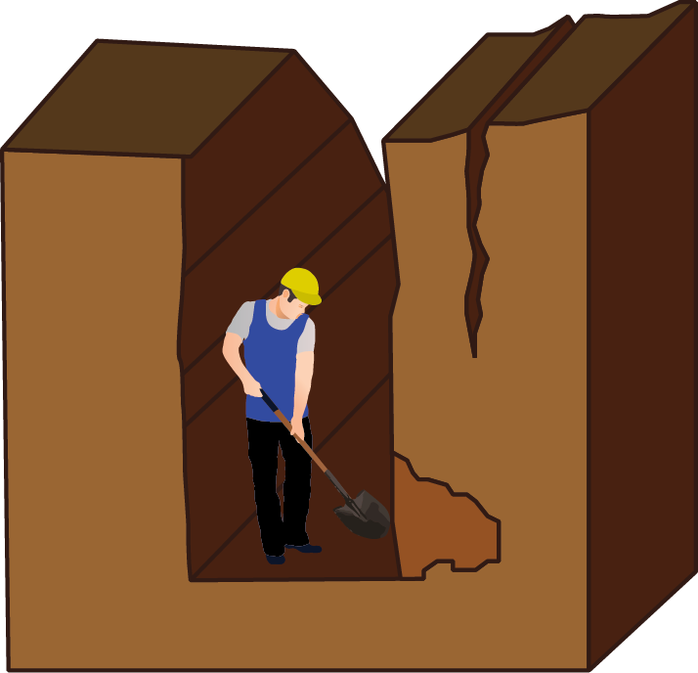
Cave-ins
Cave-in Hazards
Know the stages of a cave-in.
As a trench is excavated, inward pressure on the trench walls becomes unsupported.
As the soil’s tensile strength is reached, cracks form, running parallel to the trench. This puts stress on the base of the wall, and the path towards a cave-in has begun.
Subsidence
Soil crack
Stress
Notes:
Know the stages of a cave-in.
As a trench is excavated, inward pressure on the trench walls becomes unsupported.
As the soil’s tensile strength is reached, cracks form, running parallel to the trench. This puts stress on the base of the wall, and the path towards a cave-in has begun.
The soil at the base of the trench cannot support the weight of a “floating column ” and fails.

Slide 50
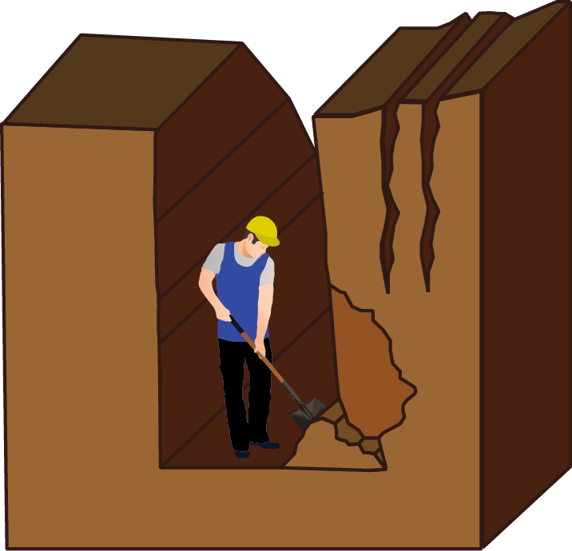
Cave-ins
Cave-in Hazards
Know the stages of a cave-in.
As a trench is excavated, inward pressure on the trench walls becomes unsupported.
As the soil’s tensile strength is reached, cracks form, running parallel to the trench. This puts stress on the base of the wall, and the path towards a cave-in has begun.
Soil cracks
Soil cracks
Stress
Stress
First cave-in
First cave-in
Notes:
The floating column is now suspended over the failed wall.

Slide 51
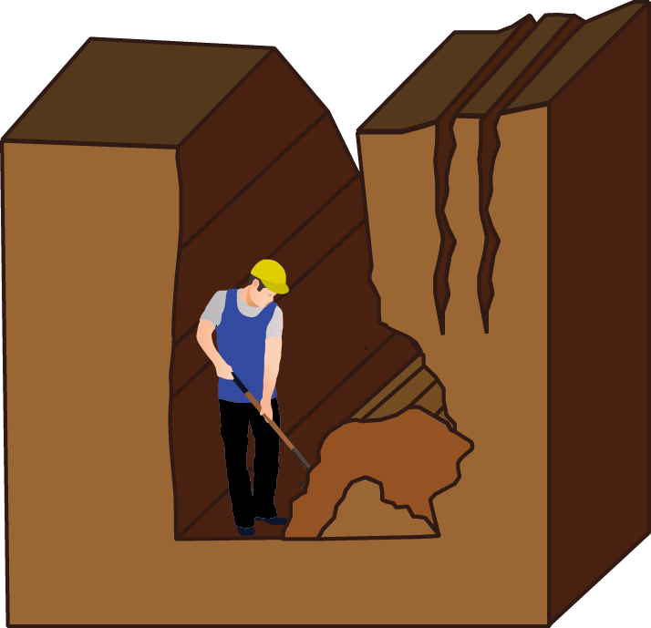
Cave-ins
Cave-in Hazards
Know the stages of a cave-in.
As a trench is excavated, inward pressure on the trench walls becomes unsupported.
As the soil’s tensile strength is reached, cracks form, running parallel to the trench. This puts stress on the base of the wall, and the path towards a cave-in has begun.
Second cave-in
Notes:
Eventually, another portion of the bottom wall will fall away as well.

Slide 52
Cave-ins
Cave-in Hazards
Know the stages of a cave-in.
As a trench is excavated, inward pressure on the trench walls becomes unsupported.
As the soil’s tensile strength is reached, cracks form, running parallel to the trench. This puts stress on the base of the wall, and the path towards a cave-in has begun.
Third cave-in
Notes:
At this point, there is not enough material left to support the weight of the wall, which collapses.

Slide 53
Cave-ins
Cave-in Hazards
Know the stages of a cave-in.
As a trench is excavated, inward pressure on the trench walls becomes unsupported.
As the soil’s tensile strength is reached, cracks form, running parallel to the trench. This puts stress on the base of the wall, and the path towards a cave-in has begun.
>2000 lbs.
Notes:
A section of soil weighing over two thousand pounds crashes into the trench, creating extreme danger for personnel inhabiting the trench floor or the failure zone above.

Slide 54
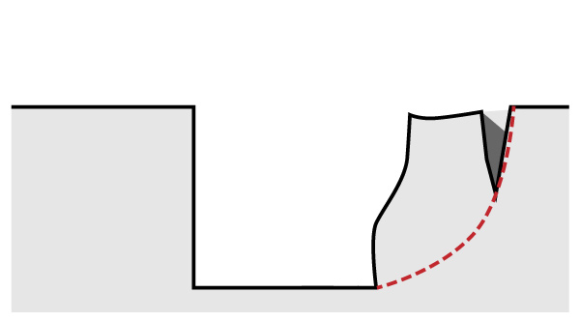
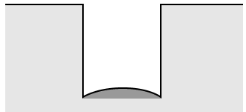
Remember the Signs of a Potential Cave-in
Cave-in Hazards
All of the following soil conditions indicate a potential cave-in!
Tension cracks
Toppling
Bulging
Bottom heaving
Never allow personnel to work in excavations that display these conditions!

Slide 55
Prevention and Protection
Cave-in Hazards
Protect all excavations from potential cave-ins that may harm personnel. Use one of the following methods:
Sloping and benching: Slope or terrace the sides of the excavation to reduce vertical soil load.
Shoring: This support system is engineered to hold soil in position and prevent a cave-in.
Shields (trench boxes): These protect workers within a walled structure should a cave-in occur.

Slide 56
Sloping and Benching
Part
5
What you need to know:
The definitions of sloping and benching
When to use sloping or benching
The angles of repose required for sloping and benching various soil classifications
Strategies for sloping layered soil classifications
Simple benching and multiple benching systems for type A and B soils

Slide 57
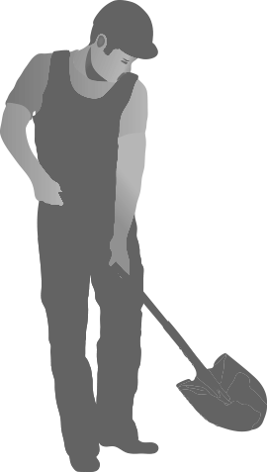
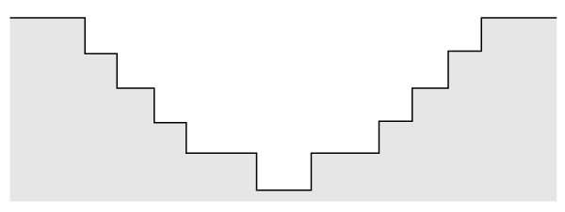
Sloping and Benching
Sloping and Benching
Sloping and benching mitigates cave-in hazards by angling the trench walls away from the bottom of the trench.
The angle in a sloping or benching system should be the same as the soil’s angle of repose and is dependent on the type of soil being excavated.
While effective, sloping and benching systems are not always practical due the limited space available or the amount of soil that needs to be removed and replaced.
Benching systems and combinations of sloping and benching are permitted for type A and B soils only.
45° Sloping This sloping system is designated for type B soils but can be used for more cohesive soils in excavations 20 feet or shallower.
45° Benching This benching system is designated for type B but can be used for more cohesive soils in excavations 20 feet or shallower.

Slide 58
Sloping
Sloping and Benching
In this example, a 10 foot deep trench is sloped at 1½:1.
Notes:
In this example, a ten-foot-deep trench is sloped at 1½-to-1.

Slide 59
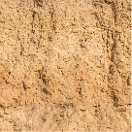
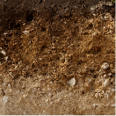
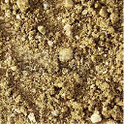
Sloping
Sloping and Benching
Permitted Soil Classifications
A
B
C
With the excavation wall sloped to this degree, a safe excavation is possible with soil classifications a, b, and c.
Notes:
With the excavation wall sloped to this degree, a safe excavation is possible with soil classifications a, b, and c.

Slide 60
Sloping
Sloping and Benching
40’
If a 10-foot-deep cut is sloped for maximum safety, the extra space necessary to accommodate slope, spoil pile, material storage, and work access may extend 40 feet or more on each side of the trench. Cost factors associated with extra excavation, spoils, backfill, compaction, and hauling make this system impractical when excavating more cohesive soils.
Notes:
If a ten-foot-deep cut is sloped for maximum safety, the extra space necessary to accommodate the slope, spoil pile, material storage, and work access may extend 40 feet or more on each side of the trench. Cost factors associated with extra excavation, spoils management, backfill, compaction, and hauling make this system impractical unless it is absolutely necessary. For excavating more cohesive soils, this wide slope is not necessary.

Slide 61
Sloping
Sloping and Benching
Permitted Soil Classifications
A
B
A steeper slope with a 1:1 angle is permitted for excavations in more cohesive soils. If you are working in type A or B soil, this approach will reduce the volume of your dig without compromising safety.
Notes:
A steeper slope with a one-to-one grade is permitted for excavations with more cohesive soils, i.e., type A or B soil, choosing this angle will reduce the volume of your dig without compromising safety.

Slide 62
Sloping
Sloping and Benching
Permitted Soil Classification
A
When excavating a homogenous area of highly cohesive type A soil, a steeper slope of ¾ run to 1 rise will offer adequate safety while further reducing the volume of the dig.
Notes:
When excavating an area of highly cohesive type A soil, a steeper slope of ¾ to 1 offers adequate safety while further reducing the volume of the dig.

Slide 63
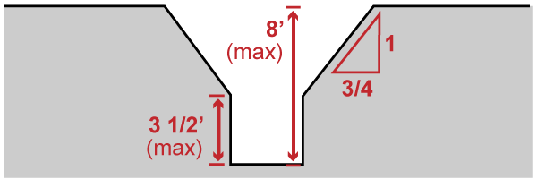
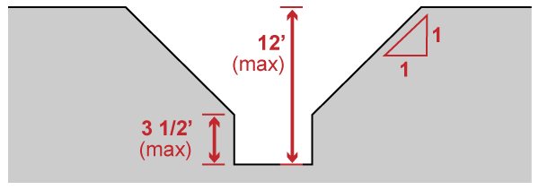
Sloping Options—Type A
Sloping and Benching
If excavating cohesive Type A soil, unsupported vertical walls with a maximum depth of 3 ½ feet are permitted at the bottom of the trench.
Requirements for overlying sloped portions of the excavation are illustrated below.
Up to 8 feet deep: The slope overlying a 3 ½ ft. vertical wall must conform to a ¾:1 or gentler rise.
8 – 12 feet deep: The slope overlying a 3 ½ ft. vertical wall must conform to a 1:1 or gentler rise.

Slide 64
Short Term Excavation—Type A
Sloping and Benching
If a simple sloped excavation will be open for 24 hours or less AND has a maximum depth of 12 feet, the maximum allowable angle is ½:1.

Slide 65
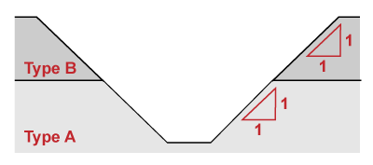
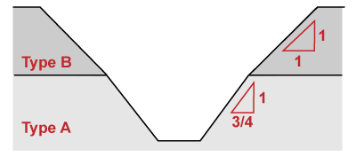
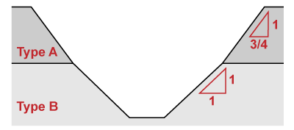
Layered Soils
Sloping and Benching
When excavating layered geologic structures, classify the soil based on the weakest soil layer.
In cases where a more stable layer lies under a less stable layer, each layer may be individually classified.
Safe A steeper slope is permitted where the more cohesive type A soil layer supports the less cohesive type B soil layer.
Safe A reduced slope is required where the less cohesive type B soil layer supports the more cohesive type A soil layer.
Not Safe A steeper slope is prohibited where the more cohesive soil layer overlays the less cohesive layer.

Slide 66
Stable Rock
Sloping and Benching
Do not slope stable rock.
Permitted Soil Classification
Stable Rock
Sloping a stable rock formation is unnecessary and impractical. When digging into stable rock formations, your excavation wall is considered safe in a vertical configuration.
Notes:
Sloping a stable rock formation is unnecessary and impractical. When digging into stable rock formations, a vertical excavation wall is considered safe.

Slide 67
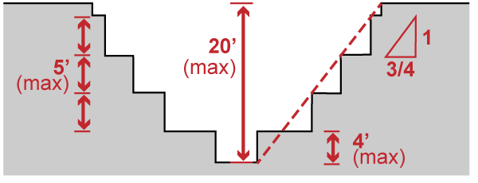
Benching Options for Type A Soil
Sloping and Benching
Simple benching system:
A simple benching system is adequate for shallow excavations under 12 feet deep.
Make a single bench at the base of the slope that does not exceed four feet in height.
The slope should originate from the excavation floor, not from the top of the bench.
Multiple benching system:
A multiple benching system is required for excavations over 12 feet deep.
Make a single bench at the base of the slope that does not exceed four feet in height.
After the first bench, make subsequent benches no higher than 5 feet. The horizontal length of each bench should accommodate the slope angle.
The slope should originate from the excavation floor, not from the top of the bench.

Slide 68
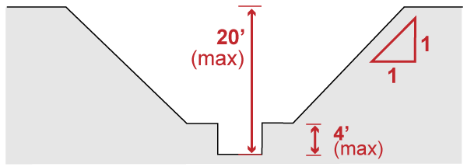
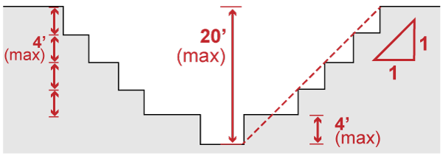
Benching Options for Type B Soil
Sloping and Benching
Simple benching system:
Make a single bench at the base of the slope that does not exceed four feet in height.
The slope should originate from the excavation floor, not from the top of the bench.
Multiple benching system:
Make a single bench at the base of the slope that does not exceed four feet in height.
The slope should originate from the excavation floor, not from the top of the bench.
After the first bench, make subsequent benches no higher than four feet. The horizontal length of each bench should accommodate the slope angle.

Slide 69
Shoring and Shielding
Part
6
What you need to know:
The components of a shoring system
When to use shoring systems
The main types of shoring systems
Guidelines for installing hydraulic shoring
Proper installation and use of a trench box

Slide 70
An Avoidable Fatality
Shoring and Shielding
Experienced Worker Killed by Trench Wall Collapse A 45-year-old leadman was buried at the bottom of a 21-foot-deep trench as he was preparing it for the installation of a trench shield. He noticed soil falling away from a wall and attempted to exit the trench but was unable to get clear before the wall collapsed and he was completely covered.
Never enter a trench with insufficient shoring or shielding.

Slide 71
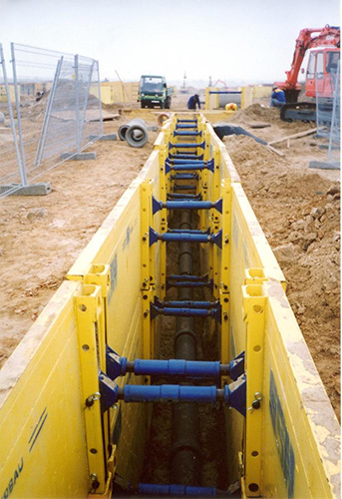
Shoring
Shoring and Shielding
Shoring systems directly support trench walls and prevent the movement of adjacent soil and structures.
Shoring provides a cost-effective and safe solution where sloping is impractical due to trench depth and limited area.
A stackable shoring box system facilitates a deep pipe installation

Slide 72
Shoring
Shoring and Shielding
Typical shoring components:
Struts (cross braces): Spans between the walls to provide lateral cross-bracing
Wales: Runs along the trench wall to support uprights or sheeting
Uprights: Provides vertical support for the wall and struts
Sheeting: Directly contacts and supports the trench wall
Not all shoring systems are required to use all components, depending on the trench depth or soil classification.
Uprights (when spaced)
Sheeting
Wale
Strut

Slide 73
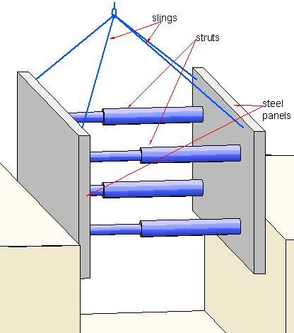
Common Shoring Types
Shoring and Shielding
Timber
A wood strut and wale system built on-site within the excavation
Hydraulic
A prefabricated steel or aluminum system that uses hydraulic pressure to engage the struts
Pneumatic
Similar to hydraulic systems, but using pneumatic pressure instead of hydraulics to engage the struts
Bill Bradley
A boxed hydraulic shoring system is lowered into a trench with slings connected to the top of the panels.

Slide 74
Timber Shoring
Shoring and Shielding
Timber shores are assembled by hand.
Construction is always completed inside the trench.
They are most useful for small or irregular excavations where customizability is required.
Timber shoring is no longer a common excavation practice because of the extensive labor required and limited ability to reuse materials.
Even when timber shoring is used, it is usually augmented with single-cylinder hydraulic struts.
Uprights (when spaced)
Sheeting
Wale
Strut

Slide 75
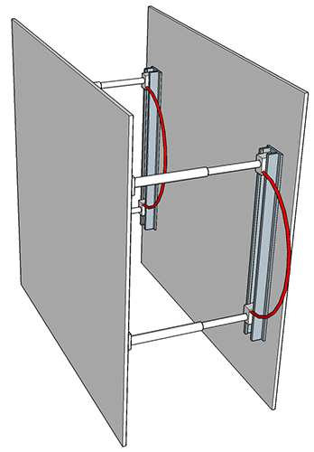
Hydraulic Shoring
Shoring and Shielding
Today, many trenching operations use prefabricated hydraulic shoring systems, which offer numerous safety advantages over timber shoring.
They can be installed or removed without entering the trench.
They are easily adaptable to fit various trench widths and depths.
They are light enough to be installed by a single employee
Pressure can be regulated so that it is evenly distributed along the trench.
They can hold themselves in place against the trench wall. They do not require support from the trench base.
This pre-manufactured hydraulic shoring system is easily unfolded and installed by a single worker standing above the trench.

Slide 76
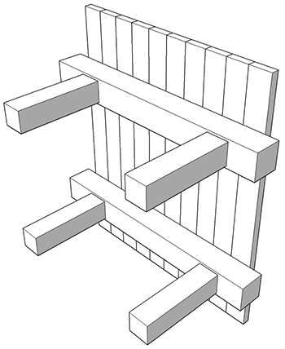
Shoring Systems
Shoring and Shielding
Timber shoring:
To design an adequate timber shoring system, do the following:
Reference the tabular data contained in OSHA 1926 Subpart P App C.
Obtain the services of a registered professional engineer.
Aluminum hydraulic shoring:
To design an adequate hydraulic shoring system, do the following:
When using a pre-manufactured system, it is critical to first reference the manufacturer-provided tabular data.
Reference the tabular data contained in OSHA 1926 Subpart P App D.
Obtain the services of a registered professional engineer.

Slide 77
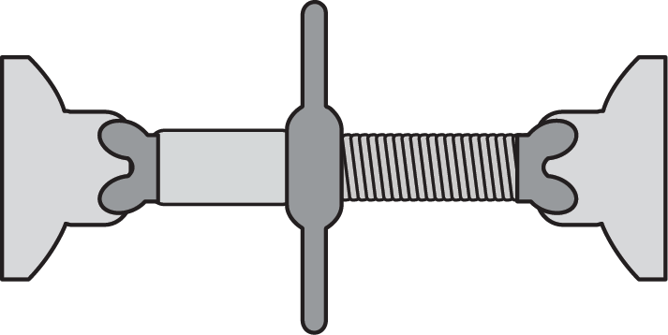
Shoring Systems
Shoring and Shielding
Pneumatic shoring:
Pneumatic shoring also uses pressurized struts to support trench walls, but they are are pressurized with air.
Pneumatic and hydraulic shoring systems share many advantages over timber shoring. However, unlike hydraulic systems, pneumatic shoring requires an air compressor on-site to engage the system.
Screw jack shoring struts (screw jacks):
Unlike pressurized shoring struts, screw jacks must be manually engaged and adjusted.
This can be hazardous for employees involved in installation, as it puts them in the trench before the system is fully engaged.
Screw jack systems are also heavy and difficult to handle, and cannot be uniformly pre-set prior to installation.
Single-cylinder hydraulic shores:
These shores are typically used to help brace timber shoring systems and shallow trenches that require cave-in protection.

Slide 78
Adjacent Structures and Underground Installations
Shoring and Shielding
Do not excavate below the level of a structural base or footing unless you are:
Excavating in stable rock.
Physically reinforcing adjacent structures or underground installations (e.g., foundations or existing utilities)
This reinforcement, also called underpinning, minimizes disruptive effects from the excavation.
Registered Engineer
A registered professional engineer must approve and direct any physical reinforcement of adjacent structures and underground installations.

Slide 79
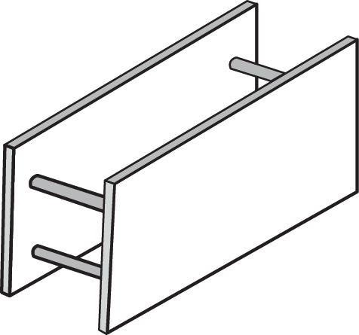
Shielding Systems
Shoring and Shielding
Unlike traditional shoring systems, which directly support trench walls, shielding systems, also called trench boxes, are intended to protect employees from cave-ins and other similar events.
Guidelines:
Refer to the manufacturer’s tabulated data when planning shielding system use.
Shielding systems are only to be used for employee protection, and are not intended for use as a shoring system or direct support of trench walls.
Keep the space between the outside of the shielding system and the trench wall as small as possible. Never subject a shielding system to loads exceeding its rated capacity.

Slide 80
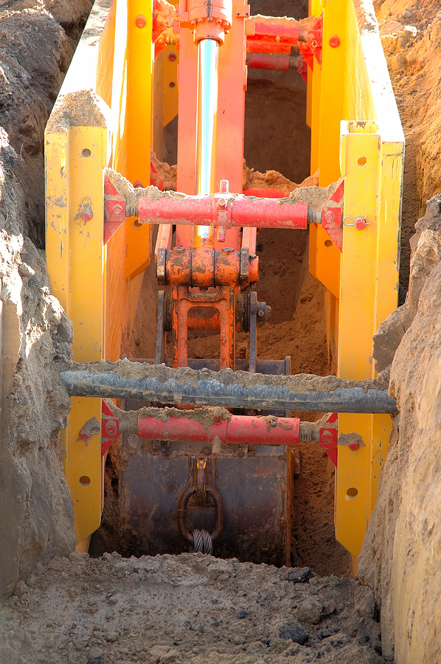
Boxed Shoring Systems
Shoring and Shielding
Prefabricated shoring boxes are similar in appearance to shielding systems, but are rated and designed for directly supporting trench walls.
Shoring boxes are assembled before they are lowered into the trench.

Slide 81
Installation and Removal of Boxed Systems
Shoring and Shielding
Install all boxed systems (shielding systems or boxed shoring systems) from the top down.
Remove all boxed systems from the bottom up.
Vacate before moving. Never move a shielding system until all employees are clear from the shielding system and trench.
Always consult manufacturer documentation before installing boxed systems.

Slide 82
Shield Stacking
Shoring and Shielding
Stack with caution:
Never stack shields unless they have been specifically designed to be stacked.
Never stack shields from different manufacturers, as their connection points may not be compatible.

Slide 83
Slope and Box Combinations
Shoring and Shielding
Trench boxes and boxed shoring systems are typically used in excavations where space is limited, but they can also be used in conjunction with sloping or benching systems.

Slide 84
Slope and Box Combinations—Angles of Repose
Shoring and Shielding
When using sloping in combination with a trench box or shoring box, conform that the slope does not surpass the maximum angle of repose for the soil classifications.
Soil Type B
The maximum depth for a combination slope and box system is 20 feet.
Soil Type A
Soil Type C

Slide 85
Slope and Box Combinations—Extension Above Soil
Shoring and Shielding
If there is sloping above the boxed system, the top should extend at least 18 inches above the level of any materials that could cave or roll into the trench.

Slide 86
Slope and Box Combinations—Space Below the System
Shoring and Shielding
The shielding system does not always need to reach the bottom of the excavation. Excavations may extend up to 2 feet below the shielding system if these conditions are met:
The shield is rated to withstand the forces presented by the full depth of the trench.
The bottoms of the trench walls show no signs of weakening.
The trench and surrounding area is closely monitored for danger signs like bulging, heaving, or boiling and for features that may affect the trenches stability, such as adjacent structures or vibration sources.

Slide 87
Slope and Box Combinations—Wall Voids
Shoring and Shielding
The forces of a cave-in can literally push a box sideways, causing a crushing hazard. After a box is positioned for the work, fill the voids between the box and the trench wall with excavated material to prevent displacement caused by a cave-in.
With additional soil material filling the exterior voids, this trench box is secure from displacement.

Slide 88
Protective System Design Requirements
Shoring and Shielding
Requirements:
Competent Person
Registered Engineer
Protective systems are only required if the potential for cave-in exists.
The competent person must inspect the site to determine the soil class, cave-in or other hazards, and requirements for access, egress, and the protective system.
A registered engineer is not required unless adjacent structures or other special hazards exist.
Under 4’ deep
The following is required:
Shoring/shielding
Sloping
Benching (unless soil is Type C)
The competent person must inspect the site to determine the soil class, cave-in or other hazards, and requirements for access, egress, and the protective system.
A registered engineer is required to approve designs provided by the competent person, address special hazards, or design sloping and benching systems.
4’ – 20’ deep
A registered professional engineer must design the protective system.
The competent person must inspect the site to determine the soil class, cave-in or other hazards, and requirements for access, egress, and the protective system.
A registered engineer is required to the protective system.
Over 20’ deep

Slide 89
General Safety Measures
Part
7
What you need to know:
Inspection requirements
Required distance for peripheral loads
Locating underground utilities and other installations
Proper access and egress points
Water accumulation strategies
Guidelines for traffic and surface crossings
Guidelines for hazardous atmospheres and confined spaces
Restrictions for working near fall hazards

Slide 90
An Avoidable Fatality
General Safety Measures
Construction Foreman Buried in Lethal Collapse of a 7-foot Deep Trench A 32-year-old field foreman was killed in a trench when one of its walls collapsed on him. The trench was approximately 7 feet deep and featured vertical, unsupported walls. The foreman was completely buried in the cave-in, and by the time rescuers reached him he had suffocated.
Experience is never a substitute for safe practices.

Slide 91
Regular Inspections
General Safety Measures
A competent person must complete and document regular inspections of the trench and surrounding area.
Minimum frequency of inspections:
Daily
Before each new shift begins
Additional inspections may be required based on the work being performed or due to certain events or conditions.
Events and conditions that may require inspections:
Natural hazards, such as rainstorms, snow, windstorms, earthquakes, or thaws
The appearance of fissures or tension cracks in the soil
The appearance of sloughing, water seepage, undercutting, bulging, or other similar conditions in the trench
Changes in location, placement, or size of spoil piles
Signs of movement or change in any adjacent structures

Slide 92
Peripheral Load
General Safety Measures
Sloped or benched excavations:
Spoil and equipment must be kept at a minimum distance of the full depth of the excavation.
Excavations with vertical walls:
Spoil and equipment must be kept at a minimum distance of ½ the depth.

Slide 93
Underground Installations and Utility Lines
General Safety Measures
Prior to beginning work on an excavation, determine the approximate position of underground installations that could intersect with the planned excavation.
Contacting authorities for help:
As required, contact state or local government agencies and utility companies or owners.
Many states require that local public utility location services be contacted prior to beginning excavation work.
Advise the authorities of the planned work and request they indicate the location of their installations.
Make sure to comply with any state and local requirements.
Proceeding without help:
Use appropriate detection methods to estimate their locations and proceed with caution if:
No response is received within 24 hours (unless state or local laws require a longer period).
The exact locations of the installations cannot be established.
As operations come close to the estimated installation locations, verify their exact locations before proceeding.

Slide 94
Access and Egress
General Safety Measures
Stairway, ladder, and ramp requirements:
A stairway, ladder, or ramp must be present in excavations that are four feet deep or more. Do not enter a trench without an established means of egress.
Stairways, ladders, or ramps must be located within 25 feet of employees.
Ladders must extend 3 feet above the excavation.
Ladders must be a single piece of equipment. Do not lash multiple ladders together to meet height requirements.
Any structural components used in a ramp or runway must be sturdy, uniform in thickness, and anchored in such a way that prevents tripping or displacement.
A competent person must design the access and egress system.
Also, a competent person qualified in structural design must design the structural ramps for vehicle use.

Slide 95
Water Accumulation
General Safety Measures
Proper control or elimination of standing water and water accumulation can help prevent the trench from collapsing.
General principles:
Divert surface water away from the trench.
In the event of a rainstorm, remove all employees from the trench.
Assure that employees are provided with, and make use of, safety harnesses and lifelines as necessary.
Use water removal equipment as needed.
A competent person must:
Be responsible for the use and monitoring of water removal equipment to assure its effectiveness.
Inspect the trench after storms, before employees are permitted to re-enter.
A registered professional engineer must approve any special supports or shield systems.

Slide 96
Vehicles and Mobile Equipment
General Safety Measures
Best practices for protecting employees from vehicle traffic:
Make sure that all employees are provided with, and make use of, suitable reflective or high-visibility garments.
Designate a flagger and assure that they have received proper training.
Post signs and signals along roads leading up to and at the trench site.
Install barricades as necessary (e.g., Jersey barriers or stop logs). Fence or barricade trenches left overnight.
If possible, grade the soil away from the trench.

Slide 97
Surface Crossings
General Safety Measures
Best practices recommend that surface crossing of trenches be avoided whenever possible. This includes foot and vehicle traffic. If crossing a trench cannot be avoided, certain criteria must be met.
Foot traffic crossings must be:
Be built separately from vehicle crossings.
Have a safety factor of four.
Include standard rails.
Extends at least two feet past the trench edge.
Have 20-inch minimum clear width.
Vehicle traffic crossings must be:
Designed or approved by a registered professional engineer.
Installed under the supervision of a registered professional engineer.

Slide 98
Hazardous Atmospheres
General Safety Measures
Atmospheric testing and suitable emergency response equipment is required when excavating in areas with hazardous atmospheres.
An atmosphere is considered hazardous if following conditions exist or could reasonably be expected to exist:
Exhaust-producing vehicles and equipment
Work activities that may produce toxic gasses or vapors, such as welding, cutting, or burning
Oxygen deficiency
Flammable substances
Toxic substances
Example areas with hazardous atmospheres:
Landfills
Contaminated soil
Utilities, such as gas or sewer
Competent Person
A competent person must test the atmosphere as often as necessary to assure continuous safety.
Displaced oxygen:
O₂ may be displaced by other gas or vapor, such as carbon monoxide from gas-powered equipment or vehicles in or around the trench.

Slide 99
Hazardous Atmospheres and Confined Spaces
General Safety Measures
Emergency response:
Emergency rescue equipment must be kept on-site whenever trench conditions could create a hazardous atmosphere or confined space hazard.
Confined spaces:
For work in excessively deep confined spaces, such as bell-bottom pier holes, make sure that all employees are wearing harnesses and lifelines.
Confined space entry practices must be in place.
Competent Person
Establish and oversee respiratory and confined space training programs.
Establish site evacuation procedures.
Remove employees from hazardous situations.
Respiratory protection program:
A respiratory protection program is required.
Respirators must be suitable for present and potential conditions.
You must be properly trained on respirator use before starting work in a hazardous or confined space.

Slide 100
Falling Loads
General Safety Measures
Best practices for protecting employees from falling loads or other objects:
Never work under raised loads.
Keep at a safe distance from equipment as it loaded or unloaded.
If operating equipment during loading or unloading, make sure that the cab or control panel is adequately guarded from the load.
Wear a hard hat that is correctly rated for your activity.
An excavation assistant stands at a minimum safe distance from a falling load.

Slide 101
Summary
When planning an excavation, a competent person must evaluate the soil classifications, anticipated worksite conditions, and any hazards.
Many contractors plan trenching operations under the assumption that all soil is type C.
Regardless of trench depth, a competent person must inspect the trench and create a protective system plan.
A registered professional engineer is frequently required to approve or design support systems for deeper excavations, adjacent structures, and underground utilities.
Tension cracks and bulges or movement in trench walls or floor are signs of an imminent cave-in.
Make trenches safer by sloping, benching, shoring, the use of shields, or some combination.
When sloping, do not exceed a soil classification’s angle of repose.

