Slide 1
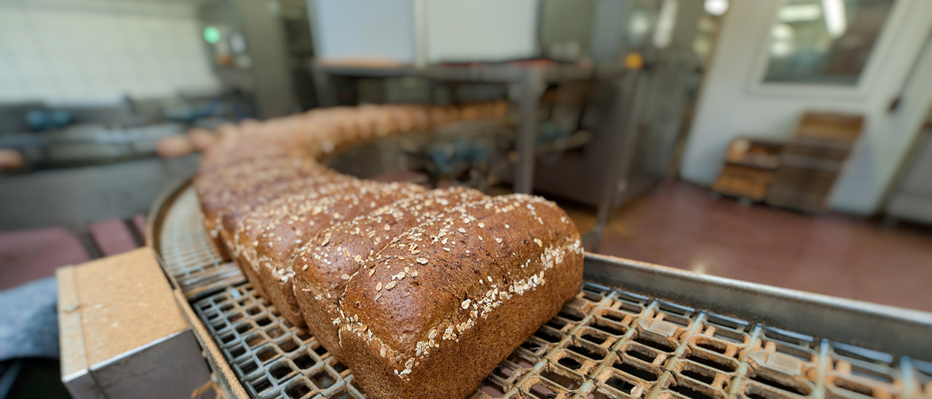
UNDERSTANDING HACCP
Hazard Analysis & Critical Control Points

Slide 2
Introduction
How to Use this Presentation
DISCLAIMER This training material presents very important, pertinent information. It should not be assumed, however, that this program satisfies every legal requirement of every state. Some states require the training be developed and delivered by an individual with specific training and experience.
This training is AWARENESS LEVEL and does not authorize any person to perform work or validate their level of competency; it must be supplemented with operation and process-specific assessments and training, as well as management oversight, to assure that all training is understood and followed. Your organization must do an evaluation of all exposures and applicable codes and regulations. In addition, establish proper controls, training, and protective measures to effectively control exposures and assure compliance.
This program is neither a determination that the conditions and practices of your organization are safe, nor a warranty that reliance upon this program will prevent accidents and losses or satisfy local, state, or federal regulations.
This presentation contains base material for use in an instructor-led training setting. You may modify this presentation to satisfy the specific training needs of your organization.
On some slides, the display text is supplemented with additional material in the slide notes.
This content is licensed for modification and use in a classroom setting. You may not redistribute this material in any form.

Slide 3
Course Overview
Introduction
Overview
Creating the HACCP Plan
The 7 Principles of HACCP
Implementation and Maintenance of the HACCP Plan

Slide 4
Overview
1
What you need to know:
The definition of HACCP
Prerequisite programs that support the HACCP Plan

Slide 5
The Definition
1 Overview
HACCP, short for “Hazard Analysis and Critical Control Points,” is a system for managing food safety by analyzing and mitigating the biological, chemical, and physical hazards that occur, or are reasonably likely to occur, at specific points in the food manufacturing process.
HACCP can be applied to any segment of the food industry and to any point in the production of food products, from ingredient procurement to distribution of the product.
WRITTEN PLAN: CODE REFERENCE
The section of the CFR governing the production of human food:
Title 21 – Chapter I – Part 120

Slide 6
Prerequisite Programs
1 Overview
A HACCP plan by itself is not enough to assure food safety! Organizations must have a solid foundation of food safety programs and practices in place to build the HACCP Plan upon.
Check applicable state and federal regulations to determine the prerequisite food safety programs your organization will need.
Commonly, the following prerequisite programs are required:
Employee personal hygiene practices
Sanitary procedures for plant, equipment, and grounds
Pest control
Ingredient supplier control and verification, including traceability of raw material batches
General food safety training for management, HACCP team members, and all food handling employees
WRITTEN PLAN: DOCUMENTATION
Document, audit, and manage prerequisite programs separately from the HACCP Plan.

Slide 7
Creating the HACCP Plan
2
What you need to know:
The 5 Preliminary Steps required to create your organization’s HACCP Plan:
Assemble the HACCP team.
Describe the product.
Identify the intended uses of the product.
Develop a flow diagram.
Verify the diagram’s accuracy.

Slide 8
First Steps
2 Creating the HACCP Plan
There are 5 Preliminary Steps to complete before your organization can implement the 7 Principles of HACCP.
It is important to complete these steps in order.
5 Preliminary Steps
Describe the Product
Identify Intended Uses
Develop a Flow Diagram
Verify the Diagram’s Accuracy
Assemble the HACCP Team

Slide 9
Assemble the HACCP Team
2 Creating the HACCP Plan
Assembling a multidisciplinary HACCP team that covers a variety of internal departments is the first step in the creation of the HACCP Plan.
The HACCP team is responsible for developing and implementing the plan.
A HACCP Coordinator is appointed to oversee the HACCP program. Coordinators must have sufficient education, experience, or training to enable them to recognize hazards.
Other members of the HACCP team include:
Experts in various aspects of the product or its manufacturing process (such as product development, engineering, quality assurance, or microbiology)
Employees with direct process experience
Maintenance and facility management personnel
The team may consult outside experts for assistance with biological, chemical, or physical hazards discovered during process evaluation.

Slide 10
Describe the Product
2 Creating the HACCP Plan
The HACCP team’s first responsibility is to assure that all team members fully understand the details of the product and its production.
The team must create a detailed and complete description of the product that describes all relevant food safety information.
For example, the description may include the following:
Ingredients used
Chemical properties, such as pH or available water
Physical end product properties, such as size, color, shape, odor, or texture
Production processes
Any methods of preservation used
Shelf life and storage conditions
Packaging process and distribution methods
Instructions and special information included on the labeling

Slide 11
Identify Intended Uses
2 Creating the HACCP Plan
Part of fully understanding the product includes knowing how it is used by consumers.
The team must identify intended uses for the product, including the product’s target audiences (e.g., general public, infants, elderly individuals, etc.) and how specific market segments may have different uses for the product.
Also, the team must identify potential consumer misuse.

Slide 12
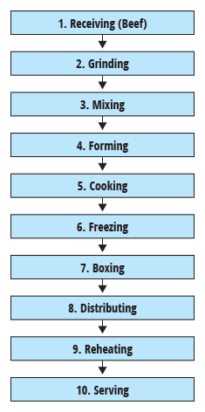
Develop a Flow Diagram
2 Creating the HACCP Plan
The HACCP team must develop a flow diagram that is a visual outline of the entire production process.
The flow diagram must include all steps in the production process that are directly controlled by the organization.
Common diagramming methods include simple block diagrams, flow charts, or simplified facility schematics.

Slide 13
Verify the Diagram’s Accuracy
2 Creating the HACCP Plan
Once the flow diagram is complete, the HACCP team must perform an on-site review, physically walking through the process to assure that the diagram accurately captures all steps and phases of the process.
Once the diagram has been verified as accurate, the HACCP team must sign and date the diagram.
Next, the HACCP Team will apply the 7 Principles of HACCP to the process.

Slide 14
The 7 Principles of HACCP
3
What you need to know:
The 7 Principles of HACCP:
Analyze hazards.
Determine critical control points (CCPs).
Establish critical limits.
Establish monitoring procedures.
Institute corrective actions.
Establish verification procedures.
Develop record-keeping procedures.

Slide 15
Overview
3 The 7 Principles of HACCP
HACCP is comprised of 7 Principles that allow HACCP teams to effectively identify, evaluate, and control food safety hazards in your facility.
Notes:
Note: This slide contains a video.

Slide 16
Principle 1: Conduct the Hazard Analysis
3 The 7 Principles of HACCP
Perform a hazard analysis to identify all biological, chemical, or physical hazards that are reasonably likely to occur and would likely cause injury or illness if left uncontrolled.
Be sure to focus the analysis on food safety hazards that could potentially cause harm.
Common analysis considerations include:
Raw materials and ingredients used in the product
Established Processing controls that prevent hazards from entering or remaining within the food product
Storage and distribution methods
Product preparation methods

Slide 17
Principle 1: Conduct the Hazard Analysis
3 The 7 Principles of HACCP
Once all hazards have been identified, evaluate each hazard to determine the best control measure. Document each hazard (e.g., in a chart or spreadsheet), and assign a control measure that will be used to prevent, eliminate, or reduce the chance of occurrence.
Ideally, the HACCP team is created before you begin hazard analysis. However, if for any reason the hazard analysis is performed first, the assembled team must verify the assessment’s completion prior to continuing to develop the HACCP Plan.

Slide 18
Principle 1: Conduct the Hazard Analysis
3 The 7 Principles of HACCP
Notes:
Note: This slide contains a video.

Slide 19
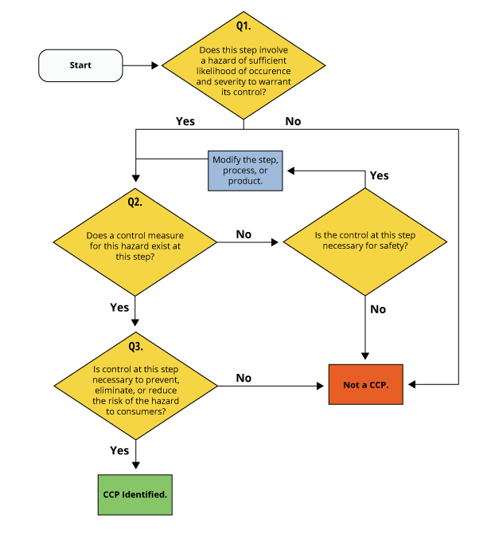
Principle 2: Determine Critical Control Points
3 The 7 Principles of HACCP
A critical control point (CCP) is any step in the process at which control can be applied and would be essential for eliminating or reducing the hazard to an acceptable level.
Using a CCP decision tree:
A decision tree is a tool that uses several rounds of questions, each with multiple potential answers, that help guide its user towards the correct decision.
Use a decision tree to determine if an identified hazard must be controlled at a CCP.
You can download a CCP Decision Tree ← here

Slide 20
Principle 2: Determine Critical Control Points
3 The 7 Principles of HACCP
Notes:
Note: This slide contains a video.

Slide 21
Principle 3: Establish Critical Limits
3 The 7 Principles of HACCP
Critical limits define the boundaries of safe production at a CCP. Hazards must be limited to a specific threshold in order for the control measures to be effective.
A CCP may have multiple critical limits that must be met—for example, in a conveyor oven, both conveyor belt speed and oven temperature may need to be closely regulated to assure that biological hazards are eliminated.
Critical limits can be derived from state, federal, or other regulatory standards as well as scientific studies, experiment results, and expert knowledge.
Critical limits are separate from operational limits, which may or may not be related to food safety.
>=155°F
155°
0:16sec
0:16

Slide 22
Principle 3: Establish Critical Limits
3 The 7 Principles of HACCP
Notes:
Note: This slide contains a video.

Slide 23
Principle 4: Establish Monitoring Procedures
3 The 7 Principles of HACCP
Once established, control measures must be monitored to assure that they are working as intended and preventing, eliminating, or reducing hazards to an acceptable level.
Establish a monitoring procedure to assure the regular review of the established control measure and to determine if and how control is lost over product safety.
Whenever possible, make monitoring a continuous process.
If monitoring cannot be performed continuously, determine a frequency for monitoring that will reliably indicate issues.
Assure that employees responsible for monitoring the CCP are properly trained and qualified to track data, report deviations, and identify trends that may indicate a safety issue at their designated CCP.
These employees must sign/initial and date any documentation used during monitoring operations, such as charts, checklists, and logs.
If possible, conducting
in-house laboratory testing is especially effective because in most cases it yields faster results than 3rd party lab testing.

Slide 24
Principle 4: Establish Monitoring Procedures
3 The 7 Principles of HACCP
Notes:
Note: This slide contains a video.

Slide 25
Principle 5: Institute Corrective Actions
3 The 7 Principles of HACCP
When a control measure fails, a corrective action must be taken to assure, at minimum, that any hazardous products are removed from production to prevent further contamination and accidental distribution.
The HACCP Plan must outline the corrective actions to be taken in the event of a control failure for each CCP.
For example:
When failed controls or potentially hazardous products are discovered:
Locate and isolate all hazardous products.
Determine the cause of the deviation.
Implement the prescribed corrective actions for that CCP.
Record the details of the incident, including the cause of the control failure and the actions taken to address the hazard.

Slide 26
Principle 5: Institute Corrective Actions
3 The 7 Principles of HACCP
Notes:
Note: This slide contains a video.

Slide 27
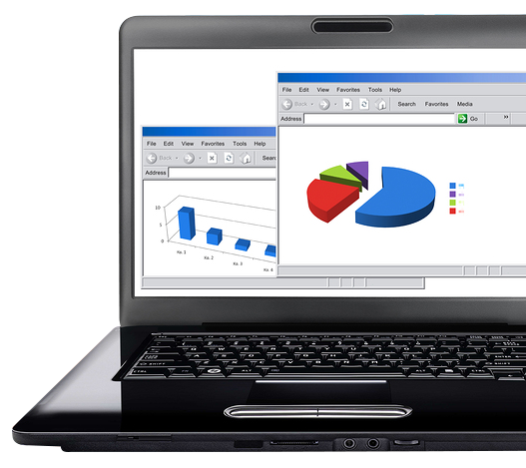
Principle 6: Establish Verification Procedures
3 The 7 Principles of HACCP
The HACCP Plan must include procedures for verification at regular intervals, not just after control measures fail.
Verification is an activity or series of activities that assure that the established control measures are functioning as intended and that the HACCP Plan has been properly implemented and remains effective.
Verification activities include:
Review of CCP monitoring records at a prescribed frequency
Ongoing review of prerequisite programs to determine effectiveness
Documentation of the reviews performed
Conduct additional reviews of the plan or specific CCPs as needed:
After an unexpected control failure
When a new hazard is identified
After a process change

Slide 28
Principle 6: Establish Verification Procedures
3 The 7 Principles of HACCP
Notes:
Note: This slide contains a video.

Slide 29
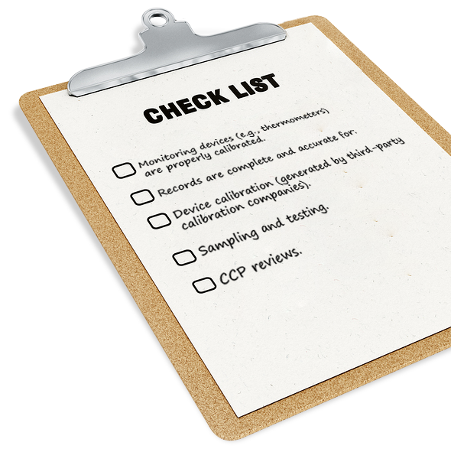
Principle 7: Develop Recordkeeping and Documentation Procedures
3 The 7 Principles of HACCP
An effective HACCP Plan includes comprehensive recordkeeping and documentation procedures. The following documents should be included:
The names and assigned responsibilities of HACCP team members
Descriptions of the product
Production and distribution methods
Intended use and consumer populations
Process flowcharts that document the production process
Raw material and process hazard analysis summaries
Critical Control Points (CCPs) and critical limits
Control procedures
Monitoring and verification procedures
Corrective actions
Validated, scientific evidence showing that the HACCP Plan will effectively control the hazards when properly implemented
Records created during the plan’s operation, such as monitoring charts and plan validation records

Slide 30
3 The 7 Principles of HACCP
Principle 7: Develop Recordkeeping and Documentation Procedures
Notes:
Note: this slide contains a video.

Slide 31
3 The 7 Principles of HACCP
Recap
1
Analyze Hazards
Case study: The raw beef patties contain harmful pathogens.
Determine CCPs
Case study: Cooking is the CCP for this hazard.
Establish Critical Limits
Case study: The patties must reach a minimum internal temperature of 155°F for 16 seconds.
Establish Monitoring Procedures
Case study: Temperature and belt speed of the conveyor oven are recorded and regularly checked at least once per hour as per the SOP.
5
Institute Corrective Actions
Case study: All suspect patties are discarded, the source of the problem is found and corrected, and new patties are checked.
Establish Verification Procedures
Case study: The HACCP Coordinator is responsible for reviewing the CCP documents each day.
Develop Recordkeeping Procedures
Case study: The team documents the full HACCP process, their team activities, and all relevant product and scientific details.
2
6
3
7
4

Slide 32
Implementation and Maintenance of the HACCP Plan
4
What you need to know:
The impact of management commitment for an effective HACCP program.
The potential reasons for HACCP Plan reassessment.
Employee training needs and training frequencies.

Slide 33
Implementing the HACCP Plan
4 Implementation and Maintenance of the HACCP Plan
The success of your organization’s HACCP Plan depends on management commitment to food safety.
Management is responsible for the creation of the HACCP team, enforcing compliance with the plan, and allocating resources to support the plan.

Slide 34
HACCP Plan Maintenance
4 Implementation and Maintenance of the HACCP Plan
In addition to conducting regular verification reviews, the written HACCP Plan requires ongoing maintenance.
The plan should be reassessed each year, or when a new product line or hazard is introduced. Failure of a control or an FDA request is also cause for reassessing the plan.

Slide 35
HACCP Training Requirements
4 Implementation and Maintenance of the HACCP Plan
Regular, thorough, and effective training is necessary to reinforce the importance of safe food production methods.
A program of food safety training must be established as a prerequisite to the HACCP Plan. Then, after the plan is created, employees must receive additional training on the specifics of the plan and their role in it.
Training should include potential hazards and implemented controls and reinforce the importance of safe production methods.
Offer an annual general awareness course for employees who do not have any direct responsibility in managing CCPs.
For employees that observe and record critical limits for a CCP and supervisors that manage these employees, offer a quarterly CCP training course. This is a great opportunity to review trends identified in the monitoring records.
All employees, including management, must receive adequate time as well as any necessary materials and equipment to complete training classes and exercises.

Slide 36
Summary
Final
HACCP is a system for analyzing and mitigating hazards that are reasonably likely to occur in the food manufacturing process.
Check applicable state and federal regulations to determine the prerequisite food safety programs you need.
The HACCP team is comprised of experts in various aspects of the product or its manufacturing process as well as employees.
Follow the 5 Preliminary Steps, in order:
Assemble the HACCP team.
Describe the product.
Identify intended uses.
Develop a flow diagram.
Verify the diagram’s accuracy.
Follow the 7 Principles, in order:
Analyze hazards.
Determine critical control points (CCPs).
Establish critical limits.
Establish monitoring procedures.
Institute corrective actions.
Establish verification procedures.
Develop record-keeping procedures.
The HACCP Plan will be reassessed yearly, if a control fails, if the FDA requests it, or when a new product or hazard is introduced.
Provide adequate employee training.
The success of your organization’s HACCP Plan depends on management commitment to food safety.

