Slide 1
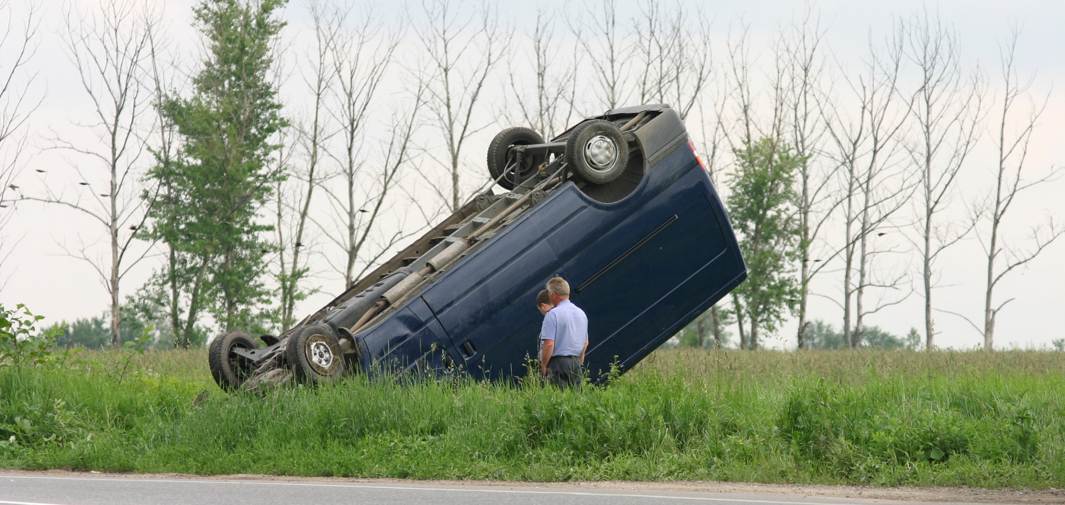
> Introduction
Incident Investigation and Analysis
Notes:
Welcome to this training presentation on Incident Investigation and Analysis.
Thank you for doing your best to learn this important information.

Slide 2
Disclaimer
> Introduction
This training material presents very important, pertinent information. It should not be assumed, however, that this program satisfies every legal requirement of every state. Some states require the training be developed and delivered by an individual with specific training and experience.
This training is AWARENESS LEVEL and does not authorize any person to perform work or validate the level of their competency; it must be supplemented with operation and process-specific assessments and training, as well as management oversight, to assure that all training is understood and followed.
Your organization must do an evaluation of all exposures and applicable codes and regulations. In addition, establish proper controls, training, and protective measures to effectively control exposures and assure compliance.
This program is neither a determination that the conditions and practices of your organization are safe, nor a warranty that reliance upon this program will prevent accidents and losses or satisfy local, state, or federal regulations.

Slide 3
Course Outline
> Introduction
Introduction
Part 1: Overview
Part 2: Preparation and Response
Part 3: The Investigation
Part 4: Analysis
Part 5: Follow-Up
Summary

Slide 4
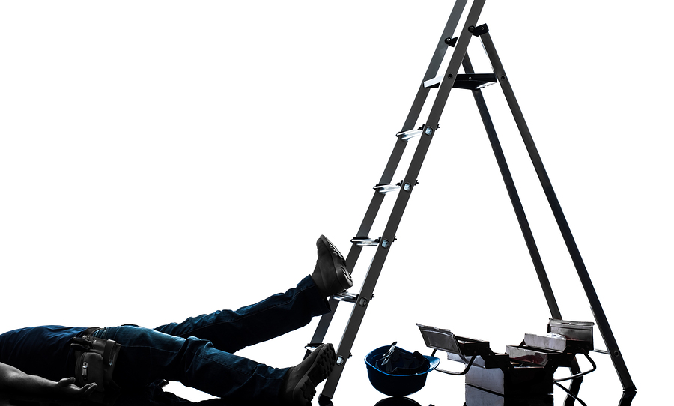
> Introduction
Save lives and money by investigating all incidents in your organization. Even a minor incident or near miss can be a warning of a major risk.
Investigate incidents in order to pinpoint the root causes. Addressing these underlying issues allows you to prevent similar incidents from recurring.

Slide 5
> Introduction
Definitions
Incident: Also referred to as an accident, an incident is an event that causes injury or death to people or damage to property.
Near miss: A near miss is an event that almost results in injury, death, or damage. A near miss is a warning sign that an incident is likely to occur, so near misses should also be investigated.
Direct cause: This is the most obvious reason that an incident occurred when the circumstances of the incident are considered.
Root cause: This is a factor that underlies the other contributing causes. It could eliminate recurrence of the problem if it is addressed.

Slide 6
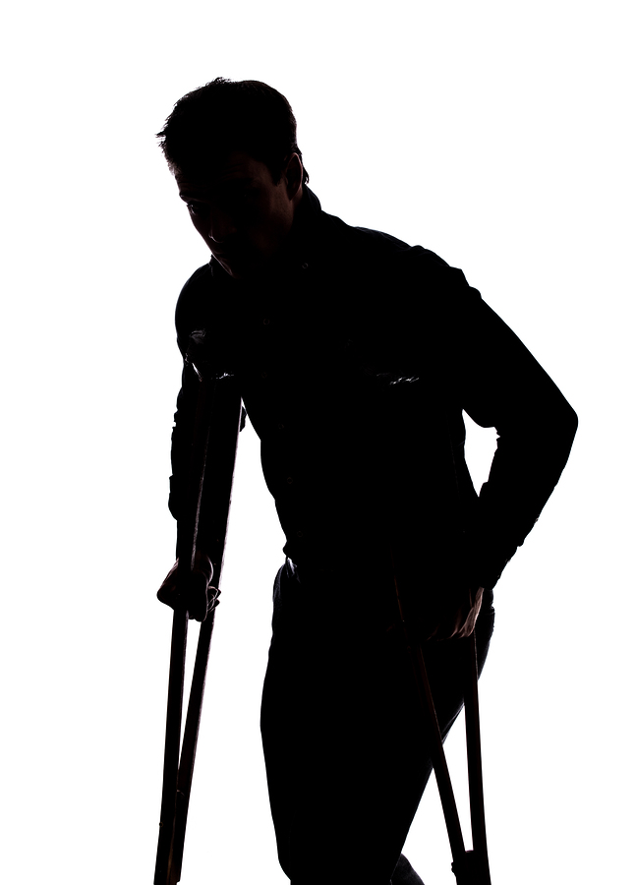
> Introduction
Respond, Investigate, and Analyze
The following slides look at organizational preparation for and response to incidents, some basic causes, how to conduct an investigation, and analysis methods.
Benefits of investigating and analyzing incidents:
Identifying unsafe conditions and behaviors
Identifying needed organizational changes
Providing constructive feedback
Reinforcing best practices
Reducing future incidents
Prioritizing the safety and well-being of everyone in the organization

Slide 7
1
Overview
What you need to know:
The safety pyramid
The importance of investigating and documenting near misses and unsafe working conditions
Unsafe acts or conditions that can lead to incidents
Organizational causes of incidents

Slide 8
1 Overview
The Safety Pyramid
1
10
1,000
10,000
100
Serious Injury or Fatality
Lost Time
Medical Only
Near Misses
Unsafe Behaviors/Hazards
Notes:
The safety pyramid compares the frequency of different types of incidents, ranging from unsafe behaviors and potentially hazardous conditions to incidents that result in serious injuries or fatalities.

Slide 9
1 Overview
The Safety Pyramid
1
10
1,000
10,000
100
Serious Injury or Fatality
Lost Time
Medical Only
Near Misses
Unsafe Behaviors/Hazards
Notes:
The less severe incidents occur more frequently. For every ten thousand unsafe behaviors or hazards observed…

Slide 10
1 Overview
The Safety Pyramid
1
10
1,000
10,000
100
Serious Injury or Fatality
Lost Time
Medical Only
Near Misses
Unsafe Behaviors/Hazards
Notes:
...there is likely to be one serious injury or fatality.

Slide 11
1 Overview
The Safety Pyramid
1
10
1,000
10,000
100
Serious Injury or Fatality
Lost Time
Medical Only
Near Misses
Unsafe Behaviors/Hazards
Notes:
While serious incidents almost always result in a thorough investigation...

Slide 12
1 Overview
The Safety Pyramid
1
10
1,000
10,000
100
Serious Injury or Fatality
Lost Time
Medical Only
Near Misses
Unsafe Behaviors/Hazards
Notes:
...minor incidents and observed unsafe behaviors are frequently not looked into...

Slide 13
1 Overview
The Safety Pyramid
1
10
1,000
10,000
100
Serious Injury or Fatality
Lost Time
Medical Only
Near Misses
Unsafe Behaviors/Hazards
Typically Documented
Typically Undocumented
Notes:
...and in many cases go completely undocumented.

Slide 14
1 Overview
The Safety Pyramid
1
10
1,000
10,000
100
Serious Injury or Fatality
Lost Time
Medical Only
Near Misses
Unsafe Behaviors/Hazards
Notes:
However, those near misses and unsafe behaviors are indicators of underlying problems that will eventually lead to a serious incident if not corrected.

Slide 15
1 Overview
The Safety Pyramid
1
10
1,000
10,000
100
Serious Injury or Fatality
Lost Time
Medical Only
Near Misses
Unsafe Behaviors/Hazards
Notes:
Always investigate and document near misses and unsafe behaviors. Addressing the problems they reveal....

Slide 16
1 Overview
The Safety Pyramid
1
10
1,000
10,000
100
Serious Injury or Fatality
Lost Time
Medical Only
Near Misses
Unsafe Acts/Conditions
Notes:
.... is key to preventing serious incidents. In addition, near misses, like incidents, must be properly reported.

Slide 17
1 Overview
Unsafe Acts
Unsafe acts are activities that create or increase the risk of injury or property damage. They result from behavior rather than a lack of skill.
Examples:
Disregard for proper procedures or training
The bypassing or disabling of safety devices
Failure to use proper personal protective equipment (PPE)
Careless, distracted, or unauthorized operation of equipment
Working under the influence of drugs or alcohol
Horseplay

Slide 18
1 Overview
Unsafe Conditions
Unsafe conditions are present when features of the worksite create or increase the risk of injury or property damage.
Examples not inherent to the worksite:
Uneven or slick walking surfaces
Damaged or improperly maintained equipment or PPE
Ergonomic hazards
Improper storage
Inadequate machine guarding
Examples inherent to the worksite:
Extreme temperatures
Heights
Air quality
Other environmental or atmospheric conditions

Slide 19
1 Overview
Organizational Causes
Accidents may stem from organizational causes that go beyond the actions or conditions at the scene of the accident.
Unsafe acts, unsafe conditions, and organizational causes are not mutually exclusive: they may all be contributing factors.
Examples:
Inadequate training
Inadequate communication
Inadequate supervision or accountability processes
Inadequate safety programs or procedures
Lack of safeguards, resources, or equipment
Lack of preventative maintenance
Non-enabled tasks
Poor hiring or placement procedures
Minimize incidents caused by unsafe behaviors by fostering a culture of safety in the workplace.

Slide 20
2
Preparation and Response
What you need to know:
Organizational preparation for incidents
Initial incident response

Slide 21
2 Preparation and Response
Organization Preparation
Make sure that your organization is prepared:
Implement effective and reliable methods of communication throughout your facilities.
Create contingency plans that cover what to do:
If managers or supervisors are unavailable.
If primary communication channels fail.
Train employees:
To properly report incidents and near misses.
To recognize and respond to emergencies.
To follow safe practices and proper procedures at all times.
Determine internal procedures to be followed during all investigations.

Slide 22
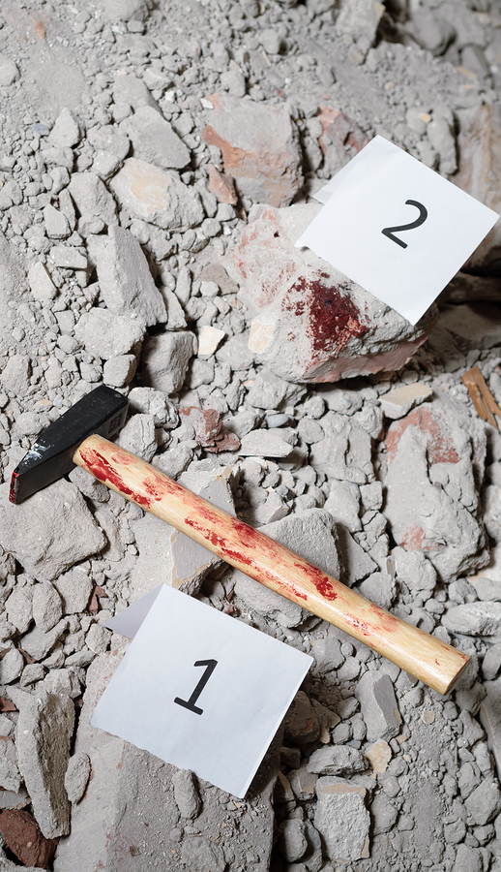
2 Preparation and Response
Initial Incident Response
Secure the area if necessary to prevent further injury or disruption of evidence.
Control or eliminate hazards created in the incident.
Contact the appropriate people immediately:
Management or supervisors
Emergency personnel if necessary
Provide first aid if necessary and able.
Start preserving evidence that may be needed for the subsequent investigation.
Photograph details of the scene before removing any evidence.
Take measures to isolate any evidence that may not be able to be removed from the scene (e.g., damaged heavy machinery).

Slide 23
3
The Investigation
What you need to know:
Investigation guidelines
Proper interview techniques
Person-focused vs. system-focused investigations

Slide 24
Investigation Guidelines
Include both management and employees in the investigation. Multiple perspectives are invaluable.
Make sure that the investigation team includes or has access to technical expertise in safety, engineering, operations, or any other subjects that might be helpful.
Focus on finding causes for the issue rather than placing blame.
Collect as much data as possible. The more information you have, the easier it will be to see the big picture.
Interview personnel involved in the accident, as well as any witnesses.
Document the site of the incident. For example, take photographs or video.

Slide 25
3 The Investigation
Collecting Data
Look for the following information:
Who was involved, including all witnesses
The time, date, and location of the accident
The activities being performed when the accident occurred
All equipment being used when the accident occurred
Existing safety policies for the activities and equipment
Information sources:
Witness accounts
Photos and evidence collected at the scene
Surveillance videos
Maintenance records, work orders, or any other documentation regarding the personnel or equipment involved

Slide 26
3 The Investigation
Interview Techniques
Conduct interviews in private.
If possible, conduct interviews close to the scene of the incident.
Plan the questions ahead of time, but allow the subject’s answers to guide what is asked next.
Do not make assumptions about what you expect the answers to be: keep an open mind.
Ask open-ended questions, allowing the subject to tell the story in their own words.
Ask who-what-when-where-why-how questions.
Do not interrupt or try to assist with an answer.

Slide 27
3 The Investigation
Focus on the System
In order to discover root causes, the analysis should be system-focused rather than person-focused.
 | Person-Focused | System-Focused
Perspective | Considers the incident to be the starting point of the issue and investigation | Recognizes that an incident may be the result of an inherent risk in the system
Scope | The direct cause of the incident and its aftermath | The system as a whole, in order to identify risk or failures
Outcome | Damage control | Process control and improvement
Notes:
In order to discover root causes, the analysis should be system-focused rather than person-focused. person-focused investigation considers the incident to be the starting point of the issue and investigation. It looks at the direct cause of the incident and its aftermath. In most cases, these investigations result in damage control but little else.
On the other hand, a system-focused investigation recognizes that an incident may be the result of an inherent risk in the system, and it looks at the system as a whole to identify risk or failures that may have ultimately led to the incident. The result is greater process control and improvement.

Slide 28
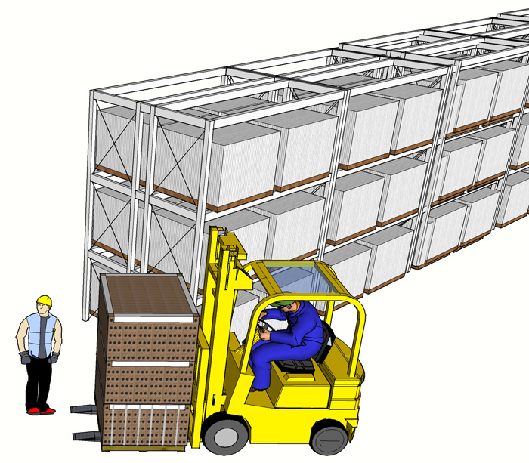
Example: Investigation Focus
3 The Investigation
Incident:
A warehouse worker’s ankle is seriously injured when he is struck by a turning forklift.
Notes:
For example, a warehouse worker’s ankle is seriously injured when he is struck by a turning forklift.

Slide 29
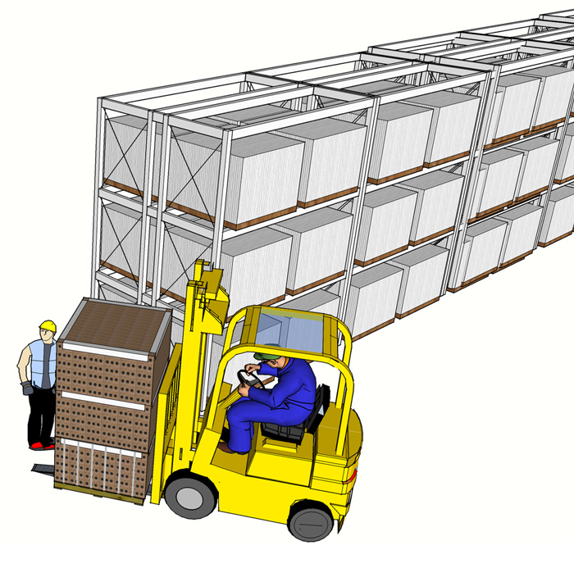
Example: Investigation Focus
3 The Investigation
Incident:
A warehouse worker’s ankle is seriously injured when he is struck by a turning forklift.

Slide 30
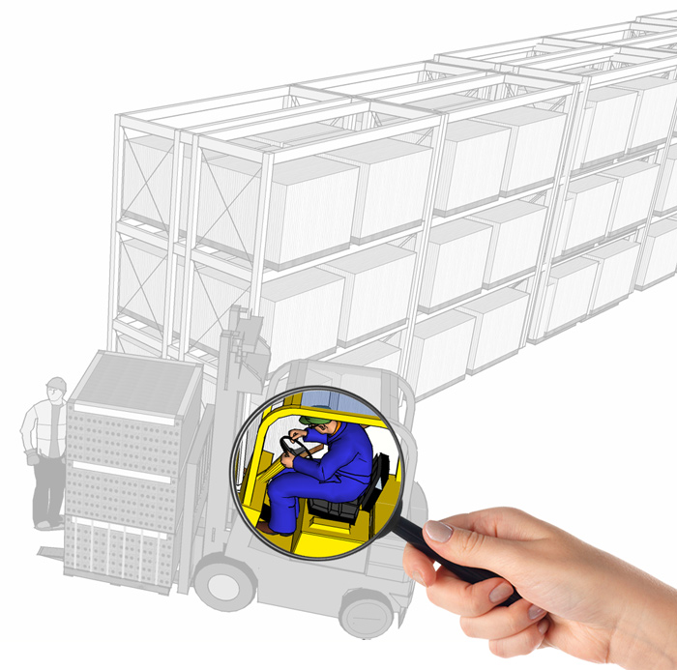
Example: Investigation Focus
3 The Investigation
Person-focused questions:
How was the operator at fault?
Was he paying attention?
Was he driving recklessly?
How serious is the damage?
What are the financial implications?
Notes:
A person-focused investigation begins by looking at the operator of the forklift. It asks the following questions: How was the operator at fault? Was he paying attention or was he driving recklessly? Why?
The investigation also looks at the direct results of the operator’s actions: How serious is the damage, including the warehouse worker’s injury and any property damage? What are the financial implications of repairs or claims?

Slide 31
Example: Investigation Focus
3 The Investigation
The Operator
Damage
Liability
Blame
Notes:
The investigation focuses on the forklift operator, quickly placing the blame on his shoulders.

Slide 32
Example: Investigation Focus
3 The Investigation
The Operator
Damage
Liability
Blame
Notes:
The end result will likely be additional training or disciplinary action, which may be unwarranted, for the forklift operator. The system will not be examined for needed changes.

Slide 33
Example: Investigation Focus
3 The Investigation
The System
The Operator
Process Failure
Inherent Risk
Variance
Damage
Liability
Blame
INCIDENT
Notes:
Remember that the goal of your incident investigation should not be to place blame: it’s to determine the true cause of the incident and make changes that reduce the chances of similar incidents occurring in the future.

Slide 34
Example: Investigation Focus
3 The Investigation
The System
The Operator
Process Failure
Inherent Risk
Variance
Damage
Liability
Blame
INCIDENT
CAUSE
Notes:
When you focus on the entire system, the incident is viewed as the possible result of process failures, inherent risks in the system, or other variances.

Slide 35
Example: Investigation Focus
3 The Investigation
The System
The Operator
Process Failure
Inherent Risk
Variance
Damage
Liability
Blame
INCIDENT
CAUSE
EFFECT
Notes:
Examining the entire system makes it easier to determine the true cause of the incident than would be possible by only looking at the effects, meaning the incident itself and its repercussions of damage, liability, and blame.

Slide 36
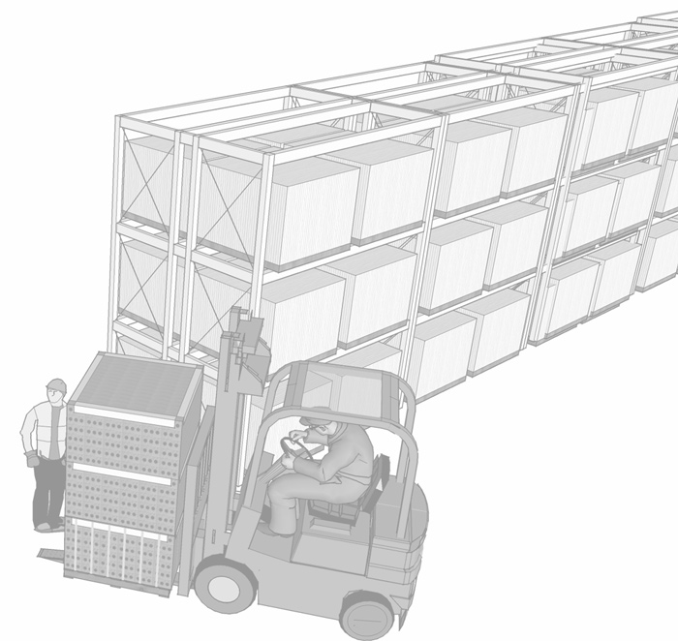
Example: Investigation Focus
3 The Investigation
The System
Process Failure
Inherent Risk
Variance
INCIDENT
Notes:
Returning to the example of the forklift operator, a systems-focused investigation leads to a different outcome.

Slide 37
Example: Investigation Focus
3 The Investigation
System-focused questions:
Was the injured worker wearing high-visibility clothing?
Were proper load-height restrictions established and communicated?
Are driving and walking zones clearly defined and separate?
Have additional traffic controls (e.g., signs, mirrors) been implemented?
Notes:
A system-focused investigation looks at anything that may have contributed to the incident, for example whether safety precautions were in place.
In this case, investigation asks the following questions:
Was the injured worker wearing high-visibility clothing?
Were proper forklift load-height restrictions established and communicated?
Are driving and walking zones clearly defined and separate?
Have additional traffic controls, such as signs and mirrors, been implemented to help the forklift operator maneuver?

Slide 38
Example: Investigation Focus
3 The Investigation
The System
Process Failure
Inherent Risk
Variance
INCIDENT
Notes:
These questions may uncover weakness in the system that, if addressed...

Slide 39
Example: Investigation Focus
3 The Investigation
The System
Process Failure
Inherent Risk
Variance
Notes:
…help to assure that the incident never happens again.

Slide 40
Example: Investigation Focus
3 The Investigation
The System
Process Failure
Inherent Risk
Serious Injury or Fatality
Lost Time
Medical Only
Near Misses
Unsafe Behaviors/Hazards
Variance
1
10
1,000
100
10,000
Risk Control Measures
Notes:
The system-focused investigation approach is especially important when analyzing minor incidents and potentially unsafe behaviors or conditions. When the system is improved to eliminate these minor hazards…

Slide 41
Example: Investigation Focus
3 The Investigation
1
10
1,000
100
10,000
Serious Injury or Fatality
Lost Time
Medical Only
Near Misses
Unsafe Behaviors/Hazards
Notes:
… the safer system helps to prevent more serious or costly injuries in the future.
While person-focused investigations are easier to conduct, they do little to make a safer system.

Slide 42
4
Analysis
What you need to know:
Analysis goals
Common misconceptions
Ishikawa diagrams
Why Method

Slide 43
4 Analysis
Analysis Goals
Once all the data pertaining to the incident has been gathered, it must be reviewed for clues as to what caused the accident.
A thorough analysis should:
Seek to identify all root causes of the accident.
Identify any possible contributory factors.
Determine actions to eliminate all causes.

Slide 44
4 Analysis
Common Misconceptions
Avoid making these assumptions:
There can only be one true cause and solution for the accident.
Incidents only occur when rules are broken.
Someone must be held accountable.
Given the same set of facts, everyone will come to the same conclusion.

Slide 45
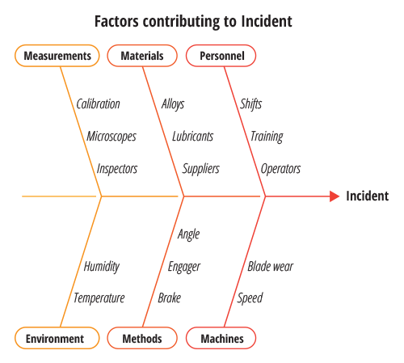
4 Analysis
Ishikawa (Fishbone) Diagrams
Ishikawa or fishbone diagrams help to identify potential factors contributing to the incident.
The diagram allows you to break down your organization into different categories, including equipment used and procedures followed. Then you can brainstorm possible causes for the incident for each category.
For example, if machine failure was involved in the incident:
Was the operator sufficiently trained to use the machine correctly?
Was the maintenance schedule for the machine correctly followed?
Was the operator or machine negatively affected by environmental factors?

Slide 46
4 Analysis
Ishikawa (Fishbone) Diagrams
Tailor the categories to best fit the environment you are working in.
Common examples:
5 M’s for manufacturing:
5 S’s for the service industry:
6 P’s for office environments:
Machines
Method
Material
Manpower
Measurement
Surroundings
Suppliers
Systems
Skills
Safety
People
Process
Policy
Plant
Program
Product

Slide 47
4 Analysis
The Why Method
Often, the easiest way to get to the root cause of a problem is simply asking “why did this happen?”

Slide 48
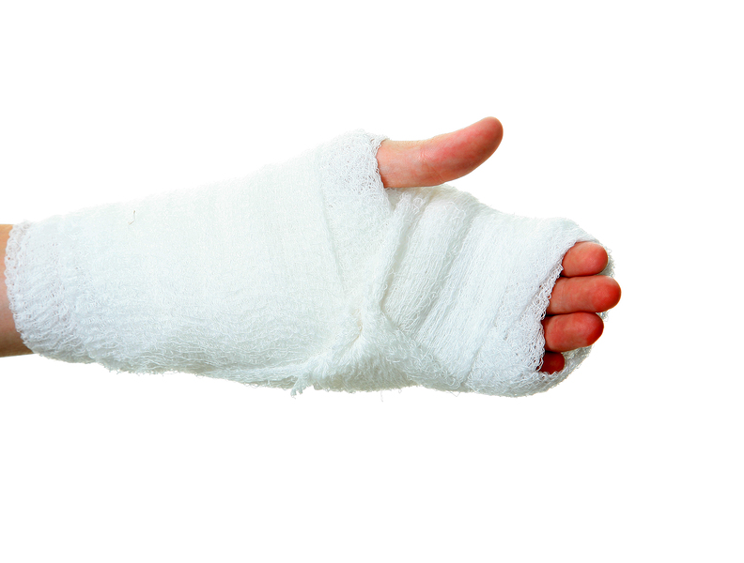
4 Analysis
Example: The Why Method
An employee was injured when her hand got caught in the belt assembly of a conveyer machine.
Question | Answer
Why did the employee’s hand get caught? | The machine’s safety guard was not installed.
Why was the machine’s guard not installed? | The belt needs to be replaced frequently.
Why does the belt need to be replaced so frequently? | The load limit of the machine is being exceeded.
Why is the load limit being exceeded? | The products on the conveyor were redesigned to be larger.
Try to think of the next question that you might ask in this scenario. Each answer may lead to multiple next questions, so be prepared to follow multiple paths of inquiry.

Slide 49
5
Follow-Up
What you need to know:
How to apply corrective actions
Follow-up procedures

Slide 50
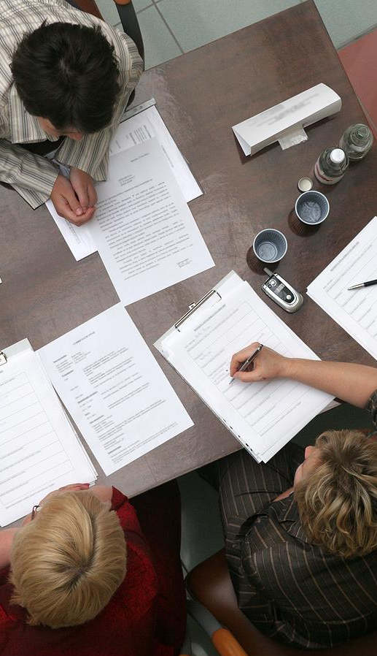
5 Follow-Up
Corrective Actions
Recommendations for corrective actions should address each root cause that was identified in the analysis.
Be specific in your instructions for what the action entails and how it should be implemented.
Keep your recommendations constructive and objective.
In situations where human error is determined to be a cause, clearly point it out in your findings, but avoid recommending disciplinary actions, which should be handled via normal Human Resources proceedings.

Slide 51
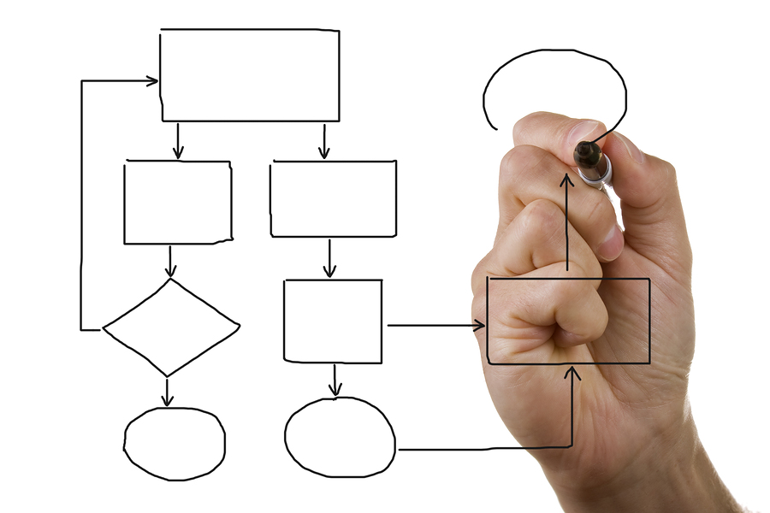
5 Follow-Up
Next Steps
After determining the appropriate corrective actions, outline a follow-up plan to assure that the actions are implemented correctly and work as planned.
Specify the responsible parties for implementation and for assuring the effectiveness of the corrections.
If hazards or risks are not corrected, review the prescribed corrective actions to assure that everything has been implemented as planned and revise the actions as necessary to address any remaining issues.
Once the issues have been verified as adequately resolved, share your results with other departments that may be subject to similar issues.

Slide 52
> Finish
Summary
Incidents can occur due to unsafe acts, unsafe conditions, or organizational failures.
Investigating even the most minor incidents, near misses, or unsafe behaviors can lead to the prevention of more serious and costly accidents.
Always look for and address root causes.
Person-focused investigations use the accident as the starting point, while system-focused investigations look at the entire system to find root causes that might have led to the accident.
Make use of methods such as the Why Method and Ishikawa diagrams.
Always document and report incidents and near misses.

