Slide 1
Introduction
How to Use this Presentation
DISCLAIMER This training material presents very important, pertinent information. It should not be assumed, however, that this program satisfies every legal requirement of every state. Some states require the training be developed and delivered by an individual with specific training and experience.
This training is AWARENESS LEVEL and does not authorize any person to perform work or validate their level of competency; it must be supplemented with operation and process-specific assessments and training, as well as management oversight, to assure that all training is understood and followed. Your organization must do an evaluation of all exposures and applicable codes and regulations. In addition, establish proper controls, training, and protective measures to effectively control exposures and assure compliance.
This program is neither a determination that the conditions and practices of your organization are safe, nor a warranty that reliance upon this program will prevent accidents and losses or satisfy local, state, or federal regulations.
This presentation contains base material for use in an instructor-led training setting. You may modify this presentation to satisfy the specific training needs of your organization.
On some slides, the display text is supplemented with additional material in the slide notes.
This content is licensed for modification and use in a classroom setting. You may not redistribute this material in any form.

Slide 2
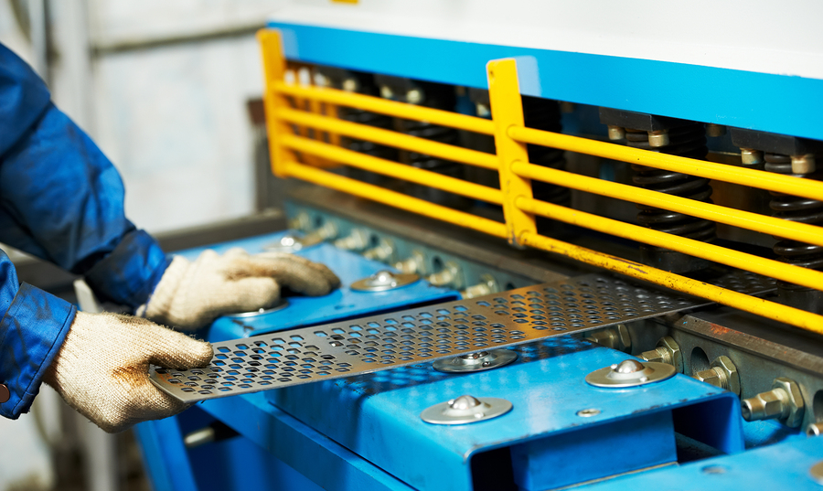
Machine Safeguarding

Slide 3
Learning Objectives
Introduction
Understand the importance of machine safeguarding.
Know the types of motion to guard against.
Implement and use various types of machine safeguarding.
Understand additional controls to put in place.
Address the hazards associated with conveyor systems.
Notes:
In this training you will learn about:
The importance of machine safeguarding
The types of motion to guard against
How to implement and use various types of machine safeguarding
What additional controls to put in place
How to address the hazards associated with conveyor systems.

Slide 4
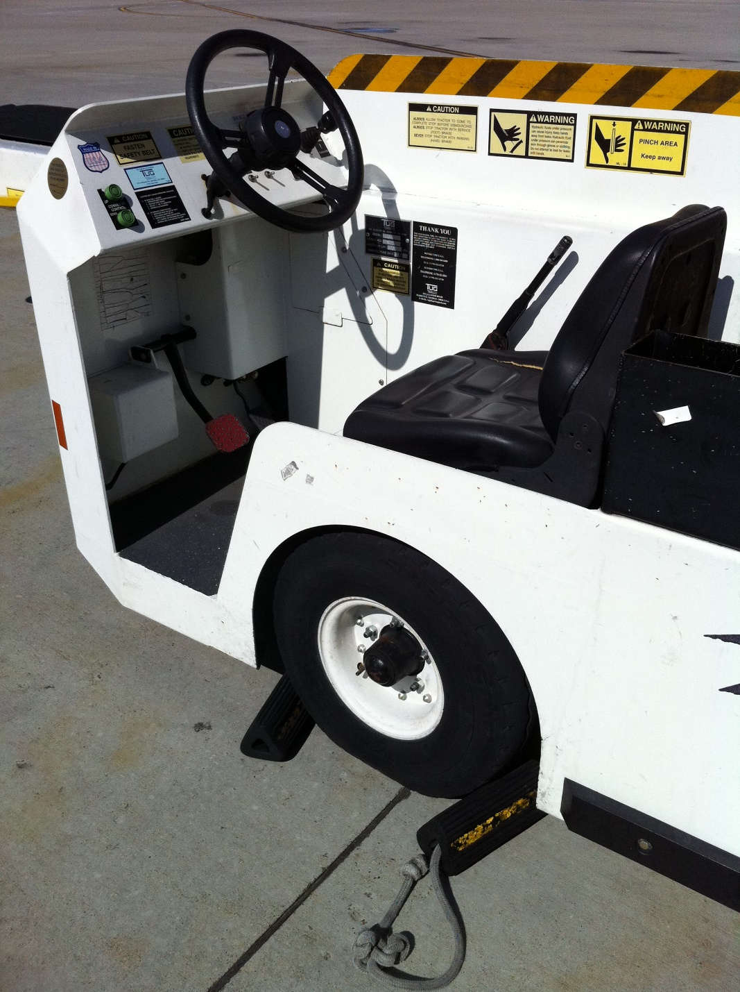
Importance of Machine Guards
Introduction
Protecting machine operators from injury
Meeting requirements
Avoiding OSHA citations
Notes:
Machine guards are essential in order to protect machine operators from injury.
Almost every kind of machine, from office equipment to construction site tools, requires safeguards.
During recent years, machine guarding has been one of the most frequently issued OSHA citations.

Slide 5
Course Overview
Introduction
DISCLAIMER This training material presents very important, pertinent information. It should not be assumed, however, that this program satisfies every legal requirement of every state. Some states require the training be developed and delivered by an individual with specific training and experience.
This training is AWARENESS LEVEL and does not authorize any person to perform work or validate their level of competency; it must be supplemented with operation and process-specific assessments and training, as well as management oversight, to assure that all training is understood and followed. Your organization must do an evaluation of all exposures and applicable codes and regulations. In addition, establish proper controls, training, and protective measures to effectively control exposures and assure compliance.
This program is neither a determination that the conditions and practices of your organization are safe, nor a warranty that reliance upon this program will prevent accidents and losses or satisfy local, state, or federal regulations.
Motion Hazards
Basics of Safeguarding
Guards
Safeguarding Devices
Other Controls
Conveyor Systems

Slide 6
Motion Hazards
1
What you need to know:
The various types of motion hazards:
Rotation
Transverse motion
In-running nip points
Cutting
Punching, shearing, or bending

Slide 7
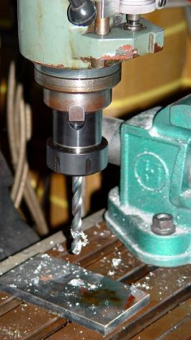
Rotation
1 Motion Hazards
Mechanisms grab loose material.
Uneven surfaces increase the hazard.
This is a “caught-in hazard.”
Examples include the following:
Drill bit
Shafts
Flywheels
The rotation of this chuck and drill presents a hazard.
Notes:
Rotating mechanisms create a hazard by grabbing loose material like clothing and hair. The machine wraps up the caught material, pulling it into the operating mechanism.
The hazard is increased if the surface of the rotating part is uneven. An uneven surface can easily catch material, like an operator’s shirt-sleeve or glove, and pull the operator onto or into the hazard.
Any time an operator can be caught in the machine, this is called a “caught-in hazard.”
Mechanisms with rotation hazards include drill bits, shafts, and flywheels.

Slide 8
Reciprocating Motion
It goes back and forth in a straight line.
It also causes a caught-in hazard.
Examples include shaker tables.
Notes:
Reciprocating motion goes back and forth in a straight line. The operator can be caught between the moving part and a fixed object.
Mechanisms with reciprocating motion hazards include shaker tables.

Slide 9
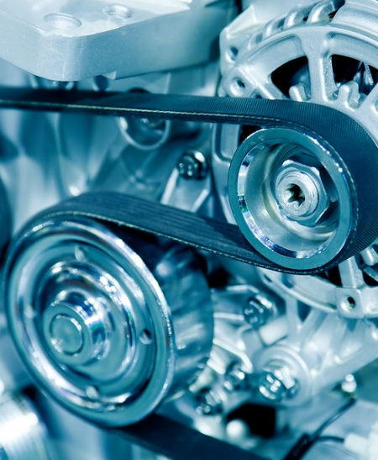
Transverse Motion
1 Motion Hazards
It moves in a straight line.
It creates pinch points.
Examples include the following:
Belt sanders
Belts moving in a single direction
Notes:
Transverse motion is movement in a straight line. Transverse motion may create pinch points between the moving part and a fixed object.
Mechanisms with transverse motion hazards include belt sanders or other belts moving in a single direction.

Slide 10
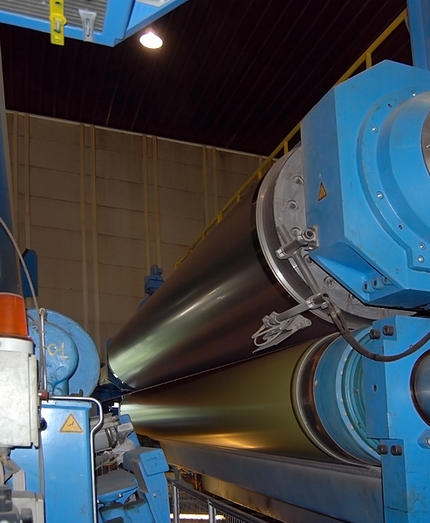
In-running Nip Points
1 Motion Hazards
These are points that rotate toward each other or a fixed component.
Examples:
Belts and pulleys
Mill rollers
Gears
Conveyor systems
The rotation of these mill rollers presents an in-running nip point as the rollers rotate toward each other.
Notes:
In-running nip points are machine points that rotate toward each other or a fixed component. This creates a nip point where the two rollers come together.
Examples include belts and pulleys, mill rollers, gears, and conveyor systems.

Slide 11
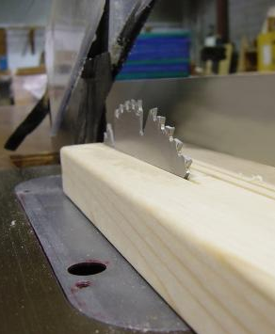
Cutting Action
1 Motion Hazards
Cutting or removing materials
Examples:
Table saw
Circular saw
Band saw
This table saw blade lacks proper guards.
Notes:
Mechanisms with cutting action, like a saw, present a cut by hazard. Such devices can also cause injuries even when they are not running, due to the sharp edge of the blade.
Devices with cut by hazards include table saws, circular saws, and band saws.

Slide 12
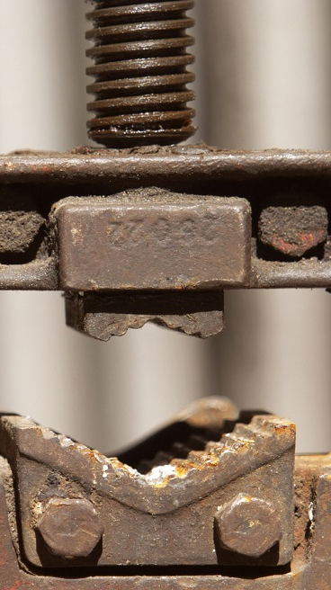
Punching, Shearing, or Bending
1 Motion Hazards
These involve two machine parts coming together.
Examples include the following:
Power presses
Press brakes
Shears
Forges
Notes:
Punching, shearing, or bending motion involves two machine parts coming together. The Operators hands or arms can get caught in between the two parts, resulting in injury.
Examples of punching, shearing, or bending devices include power presses, press brakes, shears, and forges.

Slide 13
Basics of Safeguarding
2
What you need to know:
Machine safeguarding goals and requirements
Guard removal restrictions
Machine elements to guard:
Point of operation
Power transmission apparatus
Other moving parts
Additional Requirements
Types

Slide 14
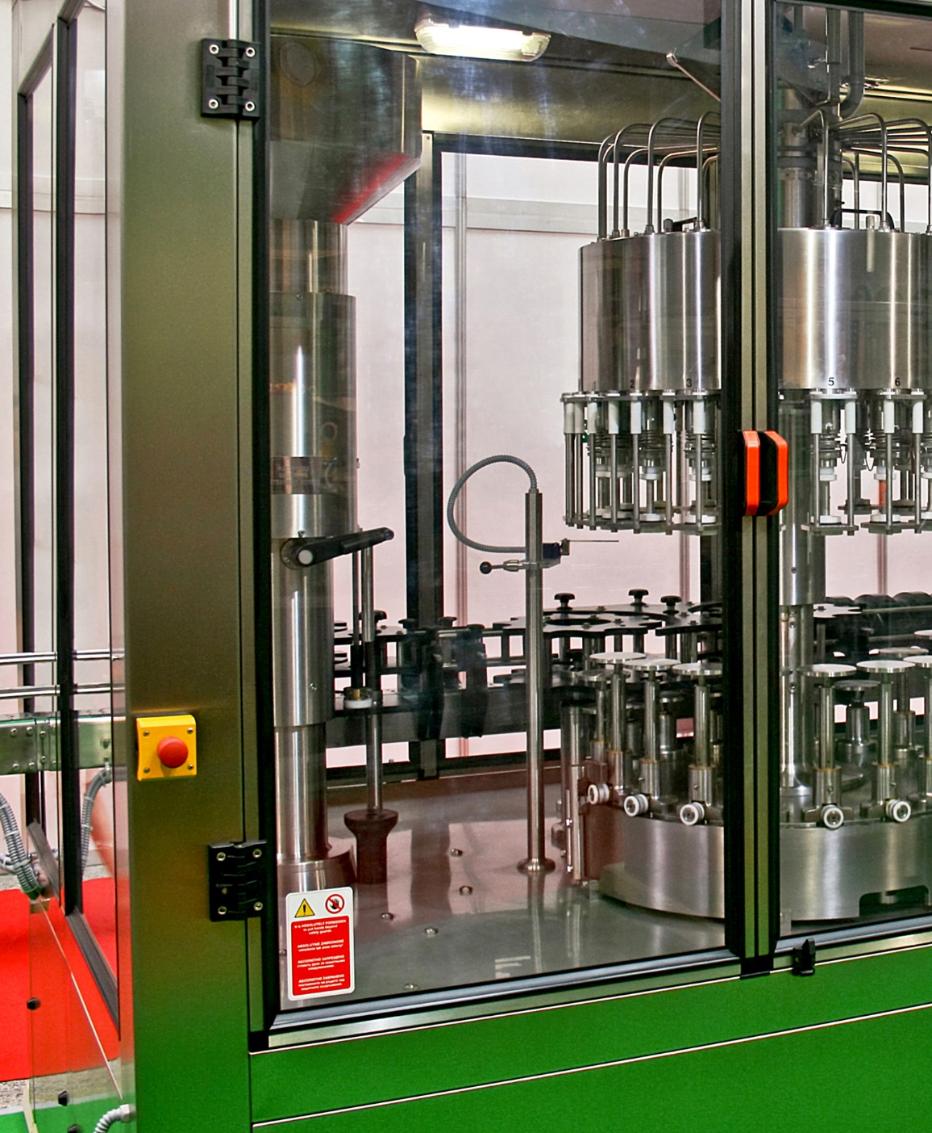
Goals of Safeguarding
2 Basics of Safeguarding
Preventing access to the danger zone during operation
Preventing objects falling into moving parts
Allowing for safe lubrication and adjustment
Being a permanent, securely-attached part of the machine that cannot be removed
Not interfering with job or presenting an additional hazard
Notes:
Guards must prevent access to the danger zone and any dangerous or moving parts during operation.
In addition, they must prevent objects falling into the moving parts and allow for safe lubrication and adjustment.
They must be a permanent, securely-attached part of the machine that cannot be removed.
Finally, they cannot interfere with the job or present an additional hazard.

Slide 15
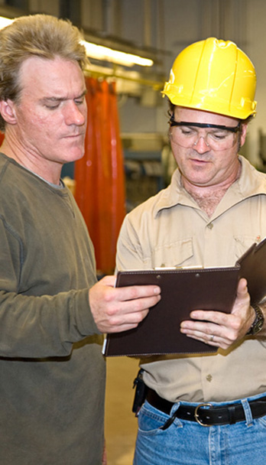
The Program
2 Basics of Safeguarding
Requirements:
Authorization
Documented training
Manufacturer instructions
Personal protective equipment
Lockout/tagout program
Preventive maintenance program
Inspections
Ongoing observations
Notes:
In addition to guards, certain practices and programs must be in place.
First, all machine operators must be authorized and trained, and their training must be documented. Operators must use machinery properly, for the purpose it was intended. They must also understand and follow the manufacturer’s instructions.
All necessary personal protective equipment must be worn.
A comprehensive and audited lockout/tagout program must be in place, and operators must adhere to it.
A preventive maintenance program is essential. Machine parts must be clean and in good condition.
Inspect equipment before use. Operators must never operate machinery that is defective. If a machine is defective or you are unable to perform the required task safely, do not use it, and notify your supervisor immediately.
Ongoing observations must be in place to assure safe operation and continual improvement.

Slide 16
Guard Removal
2 Basics of Safeguarding
Machine safeguards must only be removed to specifically address a maintenance or safety concern.
Never:
Remove or modify safeguards during operation.
Operate a machine that is unguarded.
Always:
Follow formal lockout procedures when removal of guards is necessary.
Notes:
Machine safeguards must only be removed to specifically address a maintenance or safety concern.
Never:
Remove or modify safeguards during operation or
Operate a machine that is unguarded
Always follow formal lockout procedures when removal of guards is necessary.

Slide 17
Three Areas of Safeguarding
2 Basics of Safeguarding
Points of operation
Power transmission apparatuses
Other moving parts
Notes:
Safeguarding is required for three main areas: the points of operation, the power transmission apparatuses, and all other moving parts.

Slide 18
The Point of Operation
2 Basics of Safeguarding
This is the point where the machine works on the material.
Examples include the following:
Cutting
Boring
Shaping
Forming
The point of operation on this milling machine is the point where the drill action occurs.
Notes:
The point of operation is the point where the machine works on the material. For example, the point where the saw blade cuts into wood is the point of operation.
The point of operation could also involve boring or the material being shaped or formed.

Slide 19
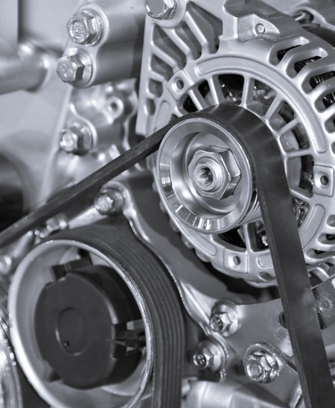
Power Transmission Apparatus
2 Basics of Safeguarding
Power transmission apparatus:
This powers the part of the machine that performs work.
Examples include the following:
Chains
Belts
Flywheels
Notes:
The power transmission apparatus powers the part of the machine that performs work.
Power transmission apparatuses include chains, belts, and flywheels.

Slide 20
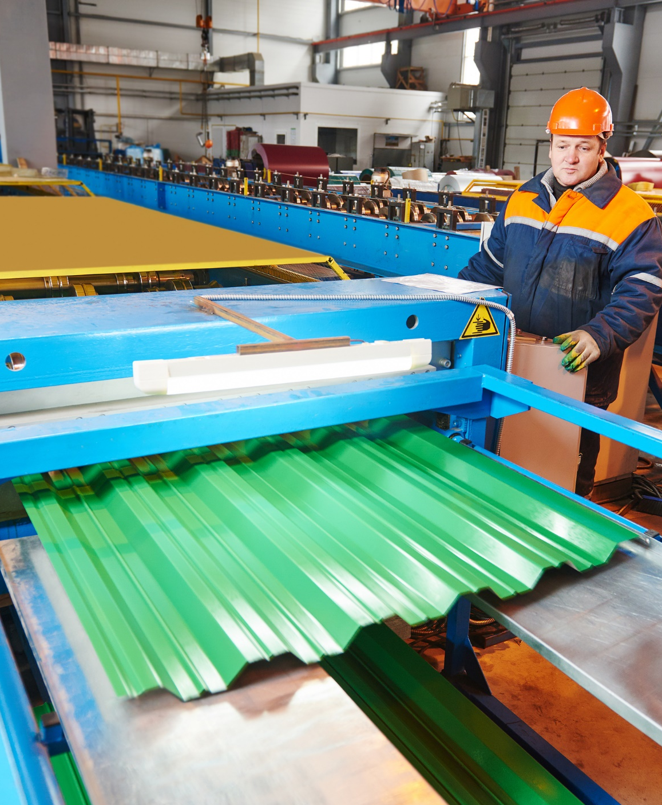
Other Moving Parts
2 Basics of Safeguarding
All moving parts of the machine must be guarded.
Examples:
Feed mechanisms
Auxiliary parts
Rotating transverse parts
Notes:
In addition to the point of operation and the power transmission apparatus, all the moving parts of the machine must be guarded.
These other moving parts can include feed mechanisms, auxiliary parts, and parts with rotating transverse motion.

Slide 21
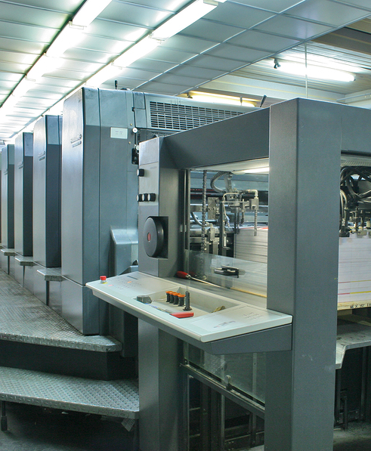
Machines with Additional Requirements
2 Basics of Safeguarding
Grinding machines
Milling machines
Drill presses
Roll-forming and roll-bending machines
Mechanical power presses
Power press brakes
Powered and non-powered conveyors
Printing presses
Shearing machines
Food slicers
Meat grinders
Meat-cutting band saws
Notes:
The following machines have additional equipment specific requirements for guards:
Grinding machines
Milling machines
Drill presses
Roll-forming and roll-bending machines
Mechanical power presses
Power press brakes
Powered and non-powered conveyors
Printing presses
Shearing machines
Food slicers
Meat grinders
Meat-cutting band saws.

Slide 22
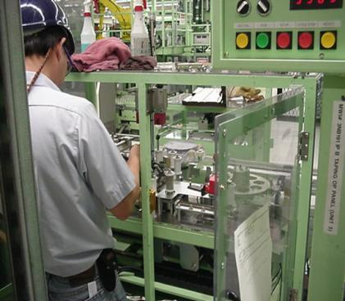
Types of Machine Guarding
2 Basics of Safeguarding
Guards
Interlocking
Self-adjusting
Safeguarding devices
Two-hand controls
Light curtains
Pressure-sensitive mats
Other controls
Emergency stops
Guardrails
Signs
Notes:
Types of machine guarding include the following:
Guards, such as interlocking guards and self-adjusting guards
Devices, such as two-hand controls, light curtains, and pressure sensitive mats;
Other controls, such as emergency stops, guardrails, and signs.

Slide 23
Guards
3
What you need to know:
General design requirements of a machine guard
Common machine guard configurations

Slide 24
Power Transmission Apparatus
3 Guards - Video
Notes:
In the picture of an assembly line shown, the power transmission device is a set of moving gears. These gears create hazards for workers standing in close proximity. Two rotating parts, like these moving gears, create in-running nip points, where the gear teeth connect to turn the assembly. Body extremities such as hair, hands, and fingers are particularly at risk of getting ensnared by these nip points. Guard the machine with a barrier, to assure that someone standing in the work zone is safely protected from moving parts and nip points.

Slide 25
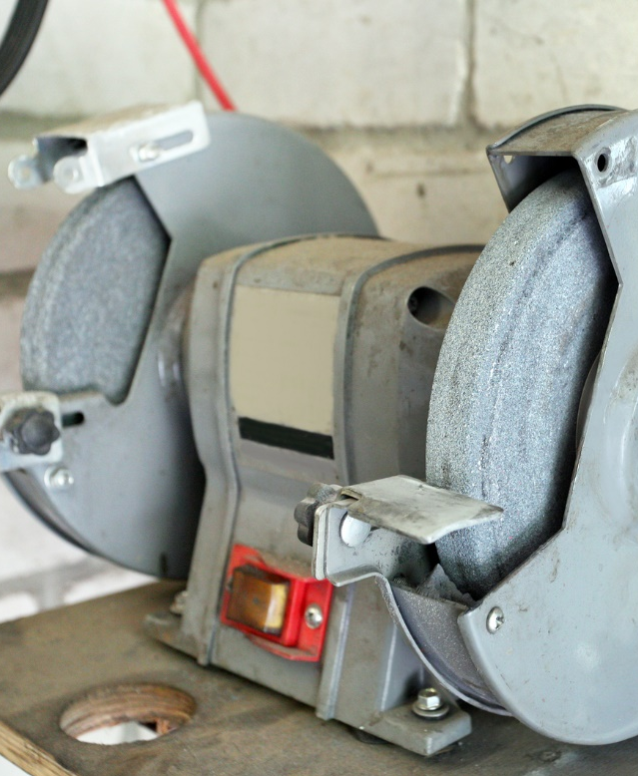
Definition
3 Guards
Guards are barriers that prevent entry into the machine.
Fixed guards are preferred.
Guards must be installed based on health and safety standards and manufacture requirements.
Notes:
Guards are barriers that protect workers from dangerous moving parts by preventing the entry of their body or clothing into the machine.
Fixed guards are the preferred control method as they are a permanent fixture and do not depend on moving parts. The specific guards discussed in this section can be all fixed guards.

Slide 26
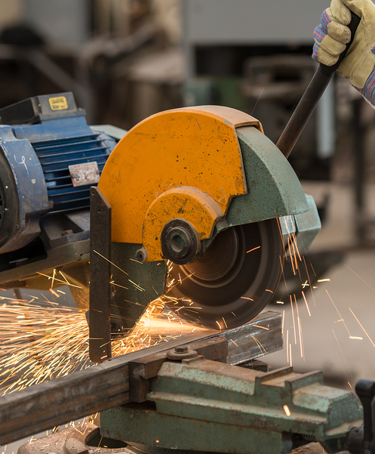
Design Requirements
3 Guards
Take hazards and limitations into account.
Minimize exposures.
Maximize control.
Fasten guards so that they require a tool for removal.
Address potential issues that impact guard effectiveness.
The shower of sparks on this cutting operation must be taken into consideration when selecting guard construction material.
Notes:
Guard design must take the hazards and limitations of the equipment into account.
Best practices focus on minimizing exposures while maximizing control.
Guards should be fastened to equipment in a way that requires a tool for removal.
When designing the right guard for the machine, address potential issues that impact the effectiveness of the guard, such as dusty environments, material that may strike the guard, the force of flying particles, or environmental factors like chemical exposure, a shower of particles, and excessive heat.

Slide 27
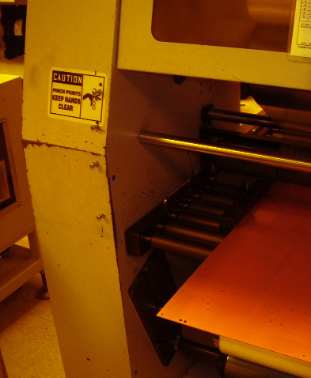
Guard Openings
3 Guards
Guards may have openings to allow the following actions:
Inserting the product into the point of operation
Accessing the machine for inspection or lubrication
Monitoring machine action
The larger the guard opening, the further an employee can reach into it.
Notes:
Guards may have openings to allow the following actions:
Inserting the product into point of operation
Accessing the machine for inspection or lubrication
Monitoring machine action.
There are established requirements for guard openings, such as the distance from the point of operation as a function of the size of the opening.

Slide 28
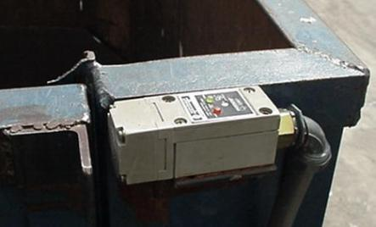
Interlocking Guards
3 Guards
Interlocking guards (interlocks) use a tripping mechanism that automatically shuts off the machine when a guard or cover is open or removed.
Interlocks with:
Proximity switches use a magnetic field.
Limit switches use a switch to initiate the starting action.
A key-activated mechanism is the preferred type.
A proximity switch on a trash compactor
Notes:
Interlocking guards, or interlocks, use a tripping mechanism that automatically shuts off the machine when a guard or cover is open or removed.
Interlocks with proximity switches use a magnetic field to control machine movement. The disadvantage to this type of guard is that any type of metal placed in close proximity to the switch can initiate the starting action.
Interlocks with limit switches use a switch to initiate the starting action of machines. The disadvantage of this type of guard is that the switch can be easily by-passed.
A safety interlock with a key-activated mechanism is the preferred type of interlock guard, because it is the most difficult system to bypass.

Slide 29
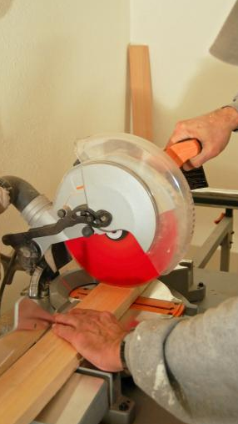
Self-adjusting Guards
3 Guards
Maintain protection at the point of operation
Adjust to allow varying sizes of stock to enter
Prevent reach-in
The guard on this circular saw adjusts as the blade goes through the stock.
Notes:
Self-adjusting guards maintain protection at the point of operation by adjusting to allow varying sizes of stock to enter the machine, while still preventing reach-in by the operator.

Slide 30
Safeguarding Devices
4
What you need to know:
The purpose of machine safeguarding devices
Safeguarding device types

Slide 31
Purpose of Devices
4 Safeguarding Devices
To inhibit operation of machines if someone is within a hazardous area
To prevent the operator from reaching into moving machinery
Notes:
Safeguarding devices are mechanical systems, such as controls or attachments, used to inhibit the normal operation of machines if any portion of a machine operator’s body is within a hazardous area to prevent the operator from reaching into the moving machinery.
For example, the device might activate if fingers are near the point of operation.

Slide 32
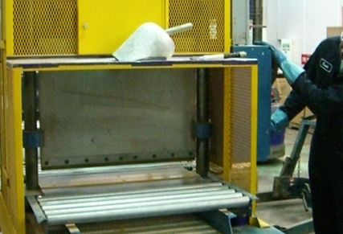
Two-Hand Controls
4 Safeguarding Devices
Require both hands for operation
Prevent operator from reaching into the point of operation
For this cutting operation, the operator’s hands stay in a safe location.
Notes:
Two-hand controls require that both hands be used for operation, preventing the operator from reaching into the point of operation.
Either the continuous pressure of two hand controls is required for the machine to operate or the controls are positioned far enough away from the point of operation that it cannot be reached during operation.

Slide 33
Light Curtains
4 Safeguarding Devices
They:
Stop the machine when the light field is broken.
Must be capable of stopping the machine’s motion anywhere.
Must be control reliable:
A single component failure will not prevent the stopping action from taking place.
Do not protect against flying objects.
Are not approved as a lockout device.
Are insufficient protection for removing jams or performing maintenance.
When installing:
Protect all cables with conduit.
Qualified personnel must make electrical connections.
Select light curtains based on size.
Notes:
Light curtains are safeguarding devices that stop the machine when the light field is broken by any part of the operators’ body.
Light curtains must be capable of stopping the machine’s motion anywhere in its stroke or cycle.
They must be “control reliable,” meaning that a single component failure will not prevent the stopping action from taking place.
Be aware that light curtains have limitations. They do not protect against flying objects, and they are not approved as lockout devices.
They are insufficient protection for removing jams or performing maintenance. Additional steps in the lockout procedure must be performed.
When installing light curtains, protect all cables with conduit.
Qualified personnel must make electrical connections. Select light curtains based on the size of the application. They can be used for perimeter guarding as well as at the point of operation.

Slide 34
Multiple Light Curtains
4 Safeguarding Devices
Multiple light curtains may allow better control of access.
They will not interfere with each other.
When installing:
Power supply and components controlling the curtains must be accessible.
Transmitter, receiver, and cabling need to be out of the way.
Transmitter and receiver must be mounted with cable connectors in the same orientation.
Notes:
Multiple light curtains may allow better control of access to the point of operation and other hazardous areas.
They will not interfere with each other.
When installing multiple light curtains, the power supply and components controlling the curtains must be accessible.
The transmitter, receiver, and cabling need to be out of the way of feedstock and other areas where they could be affected. In addition, the transmitter and receiver must be mounted with cable connectors in the same orientation.

Slide 35
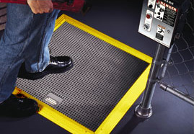
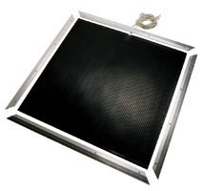
Pressure-Sensitive Mats
4 Safeguarding Devices
The mats detect a person’s presence and stop the machine.
They can protect the entire area around the machine or just at the point of operation.
A manual reset switch placed outside of the protected area is required.
Mats can be damaged by certain chemicals.
They may not be sufficient protection.
Notes:
Like light curtains, pressure sensitive mats detect a person’s presence and stop the machine.
They can protect the entire area around a machine or just at the point of operation.
A manual reset switch placed outside of the protected area is required.
Be aware that the mats can be damaged by certain chemicals and that they may not be sufficient protection for operators.

Slide 36
Other Controls
5
What you need to know:
The purpose and use of:
Emergency stops (E-stops)
Guardrails
Signage
Safe operating procedures for employees
Notes:
.

Slide 37
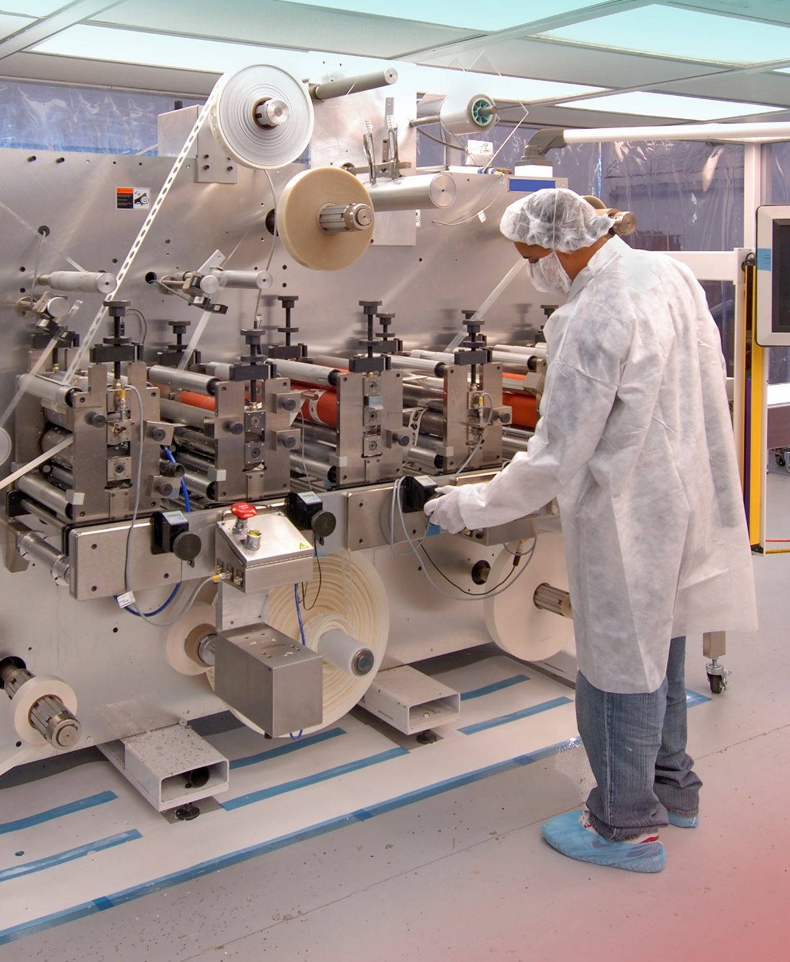
Emergency Stops (E-stops)
5 Other Controls
Used to immediately stop the machine
Must be accessible:
From the point of operation
From any location where an operator might need to shut the machine down
Notes:
Emergency stops, or E-stops, are used to immediately stop machine operations in the event of an emergency.
These must be accessible from the point of operation and also from any location where an operator might need to shut the machine down in an emergency, such as next to the conveyor belt.

Slide 38
Guardrails
5 Other Controls
Make workers aware of danger
Require training and observation of personnel
May not meet regulatory requirements
Should not be relied on exclusively
Notes:
Guardrails and similar barriers make workers aware of danger.
Training and observation of personnel are required to assure that barriers are understood and complied with.
This type of control may not meet regulatory requirements and should not be relied on exclusively.

Slide 39
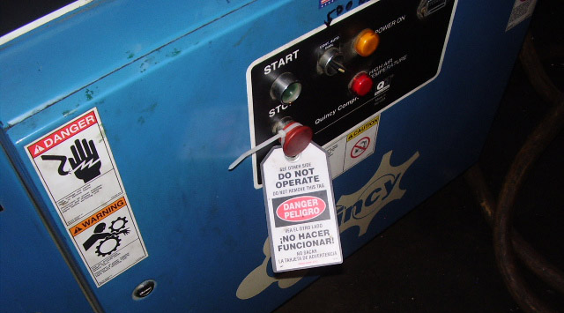
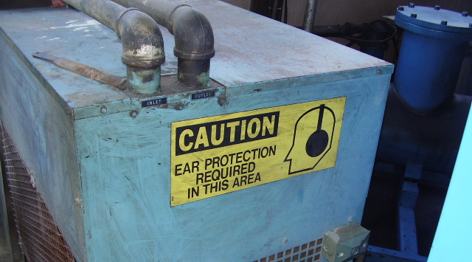
Signage
Immediate hazard
Potential hazard or unsafe practice
Notes:
Use signage in conjunction with barriers to alert workers and others of hazardous areas.
“Danger” indicates an immediate hazard.
“Caution” indicates a potential hazard or warns against an unsafe practice.

Slide 40
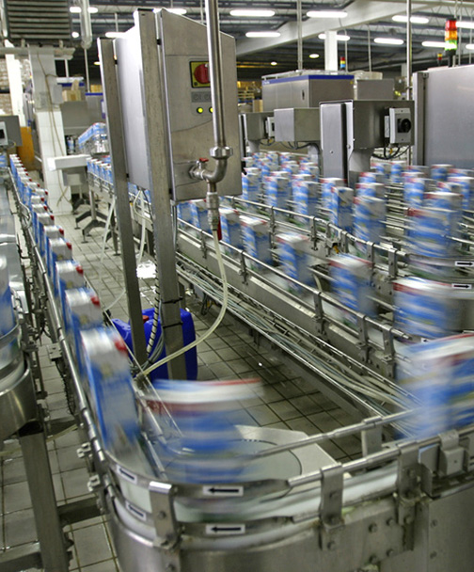
Safe Operating Practices
5 Other Controls
Only trained and authorized personnel may operate machinery.
Train employees to do the following:
Follow lockout/tagout requirements.
Be familiar with the stop and start controls:
Know their location and function.
Test them before use.
An alarm must sound prior to start.
Keep controls free of obstructions.
Before startup:
Stay clear.
Keep the area clear of obstructions.
Notes:
Safe operating practices are an essential part of controlling machinery hazards. Only trained and authorized personnel may operate machinery.
Train employees to do the following:
Follow all lockout/tagout requirements for service work or to free jams, and report all unsafe practices to the supervisor.
Operators must be familiar with the stop and start controls.
Know their location and function. To assure that they are working correctly, test them before use.
An alarm must sound prior to the start-up of conveyor systems.
Controls must be kept free from obstructions.
Before startup, all personnel must stay clear of the machine and keep the area clear of obstructions.

Slide 41
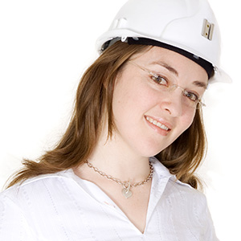
5 Other Controls
Safe Operating Practices (continued)
Train employees to tie back long hair or cover it under an article of clothing and to avoid wearing items such as loose clothing or jewelry that could get caught in moving machinery.
Notes:
Train employees to dress appropriately.
They should tie back long hair or cover it under an article of clothing and avoid wearing items such as loose clothing or jewelry that could get caught in moving machinery.

Slide 42
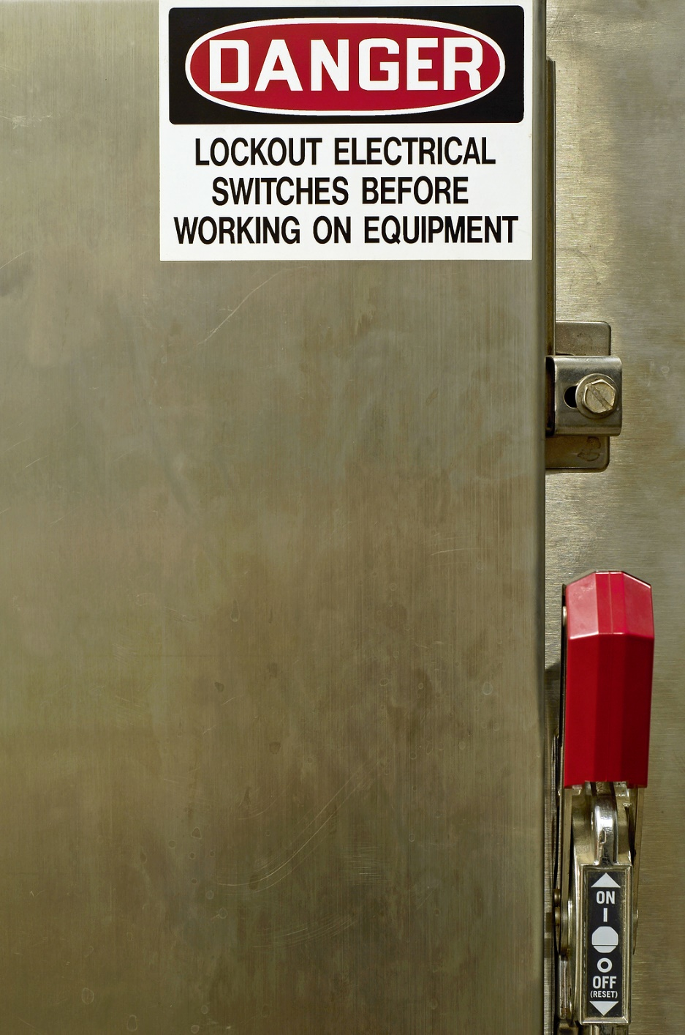
Safe Operating Practices (continued)
5 Other Controls
In the event of stoppage, the following steps should occur:
Performing lockout/tagout
Fully inspecting the equipment
Removing the stoppage mechanism before restarting
Notes:
In the event of stoppage, the following steps should occur:
Performing lockout/tagout
Fully inspecting the equipment
Safely removing the stoppage mechanism before restarting.

Slide 43
Conveyor Systems
6
What you need to know:
Conveyor hazards
Safe operation
Guards
Maintenance

Slide 44
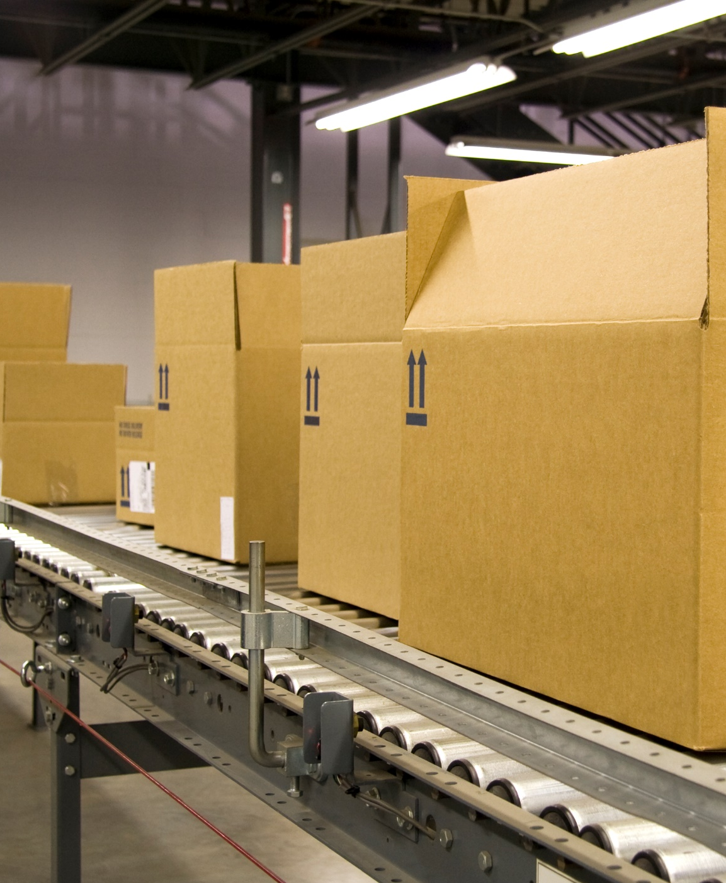
Conveyor Belt Hazards
6 Conveyor Systems
In-running nip points between rollers and belts
Pull-in hazards
Crush hazards:
Between products and the conveyor
Between the conveyor belt transfers
Products falling off the conveyor
Drive mechanisms
Notes:
A conveyor system is difficult to guard due to its many hazards. These include:
In-running nip points between rollers and belts
Pull-in hazards
Crush hazards between products and the conveyor
Crush hazards between the conveyor belt transfers
Products falling off the conveyor
Drive mechanism

Slide 45
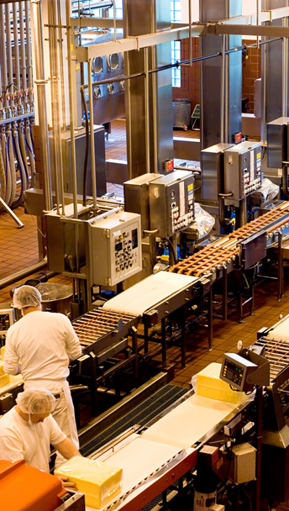
Guards and Devices
6 Conveyor Systems
Install e-stops and cable-pull systems.
Cable-pull systems can be activated by pulling at any location.
Install interlocking devices.
Notes:
Install e-stops and cable pull systems within easy reach of workers along the conveyor belt.
Cable-pull systems can be activated by pulling at any location on the cable and afford greater protection than e-stops.
Install interlocking devices that stop the machine when there is an overload or jam.

Slide 46
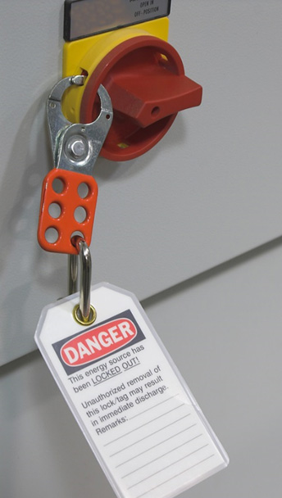
Service
6 Conveyor Systems
Service must only be performed by authorized maintenance personnel.
Service must not be performed until the motor disconnect is locked out and tagged out.
Notes:
Service must only be performed by authorized maintenance personnel.
Service must not be performed until the motor disconnect is locked out and tagged out.

Slide 47
Summary
Finish
Determine the correct machine guards.
Never remove or modify safeguards.
Never operate an unguarded machine.
All employees must be trained.
Safeguard:
The point of operation.
The power transmission apparatus.
All other moving parts.
Fixed guards are preferred, but other controls may be necessary.
Notes:
To protect machine operators from the many hazards of moving machinery, determine the correct machine guards for your facility.
Never remove or modify safeguards when the machine is in operation, and never operate an unguarded machine.
All employees must be trained on guards as part of their machine safety training.
The point of operation, the power transmission apparatus, and all parts that move while the machine is working must be safeguarded.
Fixed guards are the preferred control, but other controls may be necessary, such as additional guards, devices, and controls like barriers and signage.

